Slide 1

Social Care Policy: Where are we now?
Vic Rayner, CEO, National Care Forum
4th November 2026

Slide 2


Social care as a key priority for the Burnham government

Slide 3


Take a moment to enjoy social care being a key priority in government policy.........

Slide 4

A National Care Service.....
In the speech: a National Care Service, operating on NHS principles: free at the point of use and “where everyone contributes and everyone is covered”.
The clarification: free personal care, with individuals paying for accommodation (“bed and board”) costs.
The funding: from savings under the adjusted Triple Lock; Baroness Casey to recommend how and when it is built up
Reflections:
  Initial focus on older people – the government refers us to the Casey Commission as where the options for supporting working-age disabled adult will be explored...
  What does free personal care actually mean?
  Will the sums add up?
  How might it actually work?

Slide 5

What do we want from a National Care Service?
Clear national standards
  Better, more consistent, more sustainable commissioning across the board
  A national contract? Some way to achieve consistency of commissioning
  A clear framework for quality, transparency & outcomes
  Workforce standards
  Clear lines of accountability
Integration that works for people and providers - stop arguing about the money!
Fair funding - Meeting the full costs of care – remember the Fair Cost of Care exercise and learn from it!
A fully funded Fair Pay Agreement
Maximising the value of the public (and private) pound - £££££
Upholding rights, fairness and choice for people
Support for innovation and tech in the design of the service
Fundamentally – people at the heart of planning it

Slide 6

The Casey Commission Big Conversation
A public conversation which asks: “when we are old or disabled, or have a serious illness, who should support us and how?”
Aims:
  renegotiate the social contract around social care, who can access it and who pays
  Understand and articulate what a National Care Service could look like
‘Big Conversation’ online exercise now closed
Over 6000 proposals, with over 350,000 votes cast
Next phase will involve a Public Panel on Care:
  a representative group of people who will, over several months, consider the issues in more depth, hear evidence, discuss different perspectives & help explore common ground on the future of care
The final report has been brought forward to summer 2027.
No 10 says Casey’s work should meet four core conditions:
“The system must allow people to move seamlessly between hospitals, home care and community services.
This service must be fully and sustainably funded.
The service must start with prevention, supporting people to live independently for longer.
Citizens’ needs must be at the heart of plans, removing budget battle lines between organisations and making sure local social, primary and community care works together effectively”.

Slide 7

Workforce – a huge policy agenda for this government

Slide 8

Skills for Care – Annual Report 2026

Slide 9
Skills for Care – Annual Report 2026

Slide 10

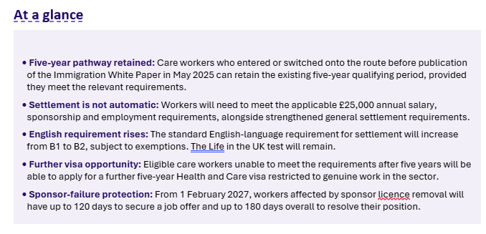

Earned settlement key announcement –a welcome reversal of the previous unfairness

Slide 11
FPA Recruitment Update
Employer side of the new Adult Social Care Negotiating Body (ASCNB)
NCF MEMBER UPDATE
19.10.2026
Notes:
Welcome. NCF is preparing its response to the Government consultation on ending one-sided flexibility in zero hours and similar contracts. Today is about testing our thinking with members.

Slide 12

ASCNB
Applications are now open for adult social care employers who are looking to join the employer side of the new Adult Social Care Negotiating Body (ASCNB).
WHAT PROVIDERS NEED TO KNOW
The Care Provider Alliance are pleased to have received an invitation from the Secretary of State for Health and Social Care, the Rt Hon Yvette Cooper MP, to nominate employer representatives to the Body. This follows the CPA being asked to convene employer representation on the Negotiating Body. The Body will negotiate the first Fair Pay Agreement for adult social care, due to be introduced in 2028.
The Care Provider Alliance (CPA) is recruiting a 31-member Employer Reference Group, from which 11 individuals will be selected to serve as formal employer negotiating members on the ASCNB, alongside four reserve members. These representatives will form the employer voice in negotiations to develop the first Fair Pay Agreement for adult social care in England.
Applications are now open. We encourage chief executives, senior leaders and others with relevant experience to express an interest and appl. The closing date is 08 November 2026 23:59.
Notes:
Set the tone: NCF is engaging constructively but critically. The proposals could affect how providers plan rotas, offer additional hours, manage short-notice change, use bank and agency workers, and respond to changing needs.

Slide 13
ASCNB
Who should apply?
The CPA is keen to ensure the employer voice reflects the diversity of the sector, including not-for-profit providers, charities, community organisations and specialist services.
We are looking for leaders with knowledge or experience of the operational delivery of adult social care and of industrial relations, particularly employment negotiations. Successful nominees will need sound judgement, the ability to analyse evidence, and a willingness to work constructively across interests. Experience of representing employer interests beyond a single organisation or setting will be especially valuable.
Notes:
These five questions sit above the detailed agenda questions. If we answer these, we have a strong, practical response.

Slide 14


Health & Care Secretary's recent announcements
On 30 September Yvette Cooper announced:
A new Champion for Unpaid Carers to 'make sure the voice of that hidden army is always heard in Government'
Reminder of the commitment to deliver the first ever legally binding Fair Pay Agreement for care workers, with minimum standards of pay and conditions across every employer
a proper workforce plan for social care, with proper career pathways, training and development
Plans to offer thousands more academy places to help young jobseekers into good jobs in care.
Plans to introduce the first ever national collective pension scheme for workers in the care sector.

Slide 15
Employment Rights Act: Timetable for change
01Oct26
Time limit to bring a claim to the employment tribunal increases from 3 to 6 months
30Oct26
Trade Union Measures:
Harassment Measures:
Strengthening trade unions’ right of access (can be digital or physical & must be a qualifying TU)
Implementing reforms to access and unfair practices during the recognition and derecognition process, including freezing the bargaining unit when an application is received
New rights and protections for trade union representatives for recognised TUs
Extending protections against detriments for taking industrial action
Requiring employers to take ‘all reasonable steps’ to prevent sexual harassment of their employees
Introducing an obligation on employers not to permit the harassment of their employees by third parties (this applies to any type of harassment)
Reinstating the two-tier code to match private sector employees the same T&Cs as employees transferred from the public sector – Due in October 2026 – However, no evidence of date or policy detail emerging
FPA regulations – laid in parliament on 3rd November 2026
01 Jan 2027
Reduction of unfair dismissal qualifying period to 6 months and uncapping compensatory awards
Duty to inform workers of their right to join a trade union

Slide 16
Employment Rights Act: What’s Coming
Mar2027
Fire and rehire protections
Action plans on gender equality and supporting employees through the menopause (mandatory for public authorities)
Action plans on gender equality and supporting employees through the menopause (mandatory for private and voluntary sector)
Bereavement leave including pregnancy loss
Collective redundancy – collective consultation threshold
Electronic and workplace balloting for recognition and derecognition ballots
Non-disclosure agreements (NDAs): regulations to prevent the misuse of NDAs in cases of workplace harassment or discrimination
Enhanced dismissal protections for pregnant women and new mothers
Flexible working
Introduction of the right to guaranteed hours and the right to reasonable notice and short notice payments
Apr2027
Aug2027
Sep2027
Oct2027
Pending Date
Note: Industrial relations framework no longer in timeline​

Slide 17

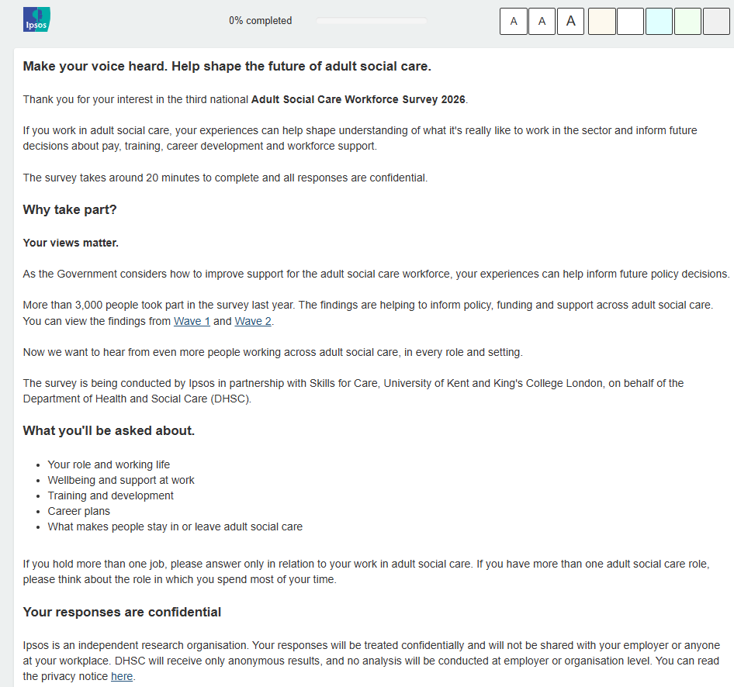
Please encourage all colleagues to complete the Adult Social Care Workforce Survey 2026

Slide 18

Other hot topics in social care policy world

Slide 19
Supported Housing Licensing - Consultation on Draft Regulations
In 2025, the government consulted on proposals to introduce a local authority-run supported housing licensing scheme.
The response to this consultation established that, to have a licence, supported housing providers should meet certain requirements
These include new National Supported Housing Standards which establish baseline requirements for the support, staffing and environment in supported housing.
Some types of supported housing will be exempt from the scheme.
The new consultation launched recently is about the draft regulations to bring the licensing scheme into force, and testing whether they will successfully deliver the proposed licensing scheme.
The regulations provide significantly more detail on how the scheme will be established and administered, and how licences will be awarded, varied (e.g. if a service manager changes) and revoked where necessary.
We are running a session for members to discuss the consultation and our response on 18th November, 11am-12pm.
This consultation closes on 10th December.

Slide 20
Neighbourhood Health – are there opportunities if we can get in the conversation now? Some ideas....
Develop a clearer national framework with local flexibility – a national minimum, reduce variation, some local adaptation
Move from signposting to active coordination – clearer pathways, less 'navigation' needed
Invest in and build on existing community assets including social care providers & VCSE services; don't default to new NHS infrastructure
Adopt a broader "Neighbourhoods of Care" approach - see health as one outcome of strong communities rather than the sole objective.
Focus on prevention rather than crisis
Give social care, housing and VCSE organisations equal status - genuinely reflect a wider system rather than primarily NHS priorities.
Create funding models that support integration –stop arguing about the money
Invest in social care infrastructure & create local hubs where health, care and community support can come together.
Strengthen co-production and community voice - Neighbourhood health should be informed by communities
Explore technology as an enabler - practical mechanisms that could help support care closer to home.

Slide 21
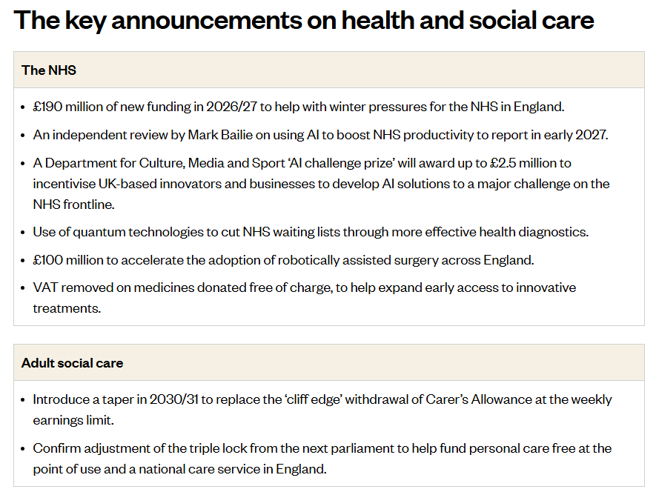
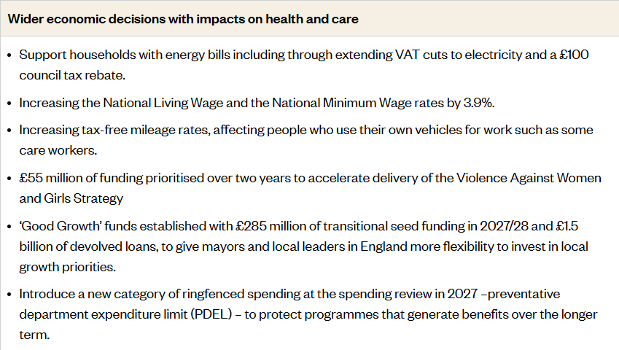
Helpful summary of the October 2026 budget from The Kings Fund
Rough sleeping
Combination of new funding and reprioritised existing Ministry of Housing, Communities and Local Government budgets to tackle rough sleeping and invest in a route off the streets across the rest of this parliament.

Slide 22
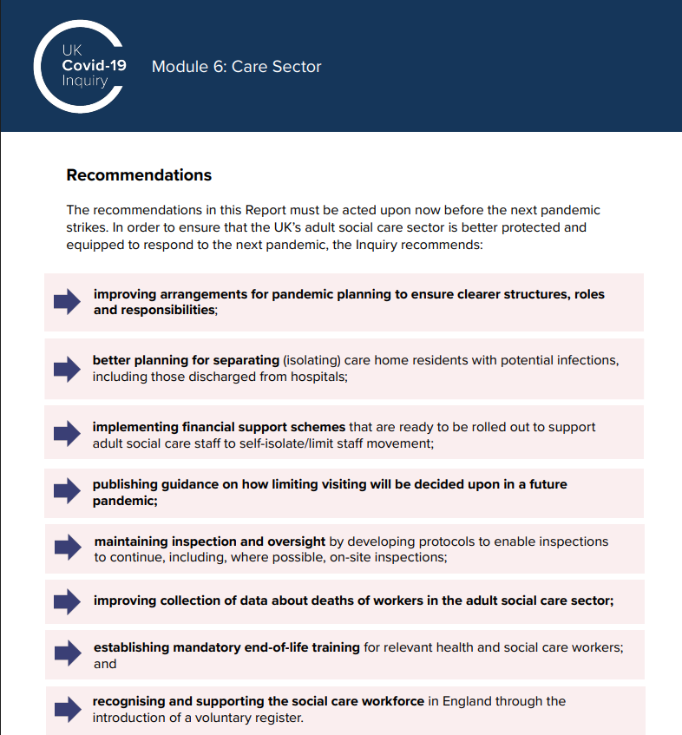

COVID Inquiry Module 6 Report – many learnings for systemic social care reform
Module 6 has gathered more than 170 written statements and more than 100,000 pages of evidence.
NCF was one of 27 core participants in Module 6.

Slide 23

Independent Report into mental health conditions, ADHD and autism
Recommends 'a fundamental shift from a ‘diagnosis-dependent’ system to a ‘needs-led plus diagnosis’ system. The heated debate about whether there is too much diagnosis or too little risks reinforcing the centrality of diagnosis rather than need and timely access to support and treatment.
The government must address 2 failures at the same time:
People wait far too long for support, diagnosis and treatment.
Diagnosis has become the primary gateway to support that could and should be available earlier.
These failures sit alongside insufficient capacity for people with the most severe, enduring and complex needs.'
10 Recommendations:
Tackle the drivers of mental distress & ill health via an ambitious approach to prevention, early intervention & improving public mental health and wellbeing.
Move from a ‘diagnosis-dependent’ to a ‘needs-led plus diagnosis’ system
Commission & deliver integrated, digitally-enabled mental health & neurodevelopmental assessment and support
Close treatment gaps while protecting, strengthening & investing in specialist services to improve access & outcomes for those with the most severe, complex & enduring needs
Overhaul the commissioning, funding, oversight and regulation of mental health & neurodevelopmental services
Build capacity & capability across the multidisciplinary workforce to deliver more integrated mental health and neurodevelopmental support
Take an ambitious approach to scaling up safe digital & AI-enabled tools within a digitally enabled & integrated care pathway, while sharing &using data to improve quality of care, efficiency & productivity.
Improve data collection & evaluation for mental disorders, ADHD & autism to strengthen the evidence-base for policy development / implementation.
Commission a national public information & education campaign to help people better understand, support and accommodate neurodevelopmental conditions and manage their mental health
Publish a cross-government mental health strategy to implement these recommendations – action now (12 –24 months) & a 10 year plan.

Slide 24


CQC and Regulation

Slide 25





Lots happening at the CQC …...
New CEO - Emily Miles – come from the Department of Environment, Food and Rural Affairs - joined 19 October
Rabbi Baroness Neuberger DBE new Chair of the CQC & started 1 October
Next steps in the Dementia Strategy: Developing new statutory guidance on what good dementia care looks like – get involved
2026 State of Care Report published – Friday 23 October

Slide 26
State of Care 2026
Quality remains uneven: Well-led continues to be the weakest area and quality remains uneven depending on the type of care (care homes perform worse on average than homecare and supported living), and depending on location (only 59% of care homes in the North West region are good or outstanding.
The market is reshaping: care homes are consolidating into fewer, larger services, while homecare is becoming increasingly fragmented.
Care home property ownership is increasingly consolidating under institutional investors. The number of homes by the top 5 largest providers of care homes for older people ahs increased by 26% in 2 years; meaning Welltower now owns 9% of all CQC-registered ‘beds’.
Financial sustainability is under strain: local authorities overspent adult social care budgets by £715m, increasing pressure on commissioning and provider viability. Providers are increasingly seeking more self-funded people to secure their sustainability.
Workforce pressures persist: vacancy and turnover rates are improving by very small margins, but international recruitment has fallen sharply and recruitment risks remain. Staffing is a key indicator of quality.
System capacity remains critical: social care shortages and transfer delays each account for 12% of delayed hospital discharges, reinforcing the need for stronger system working.

Slide 27
Technology – Driving change

Slide 28


​
Some handy checklists – Cyber incident checklist from the Digital Care Hub and AI Risk Management Toolkit
This checklist covers the practical steps that are easy to overlook until they are needed. They prompt providers to identify key roles, keep printed and offline copies of important contacts, agree back-up communication routes, prepare short holding statements and practise their response at least once a year. They also include prompts for the first few hours of an incident, stakeholder updates and post-incident review.

Slide 29
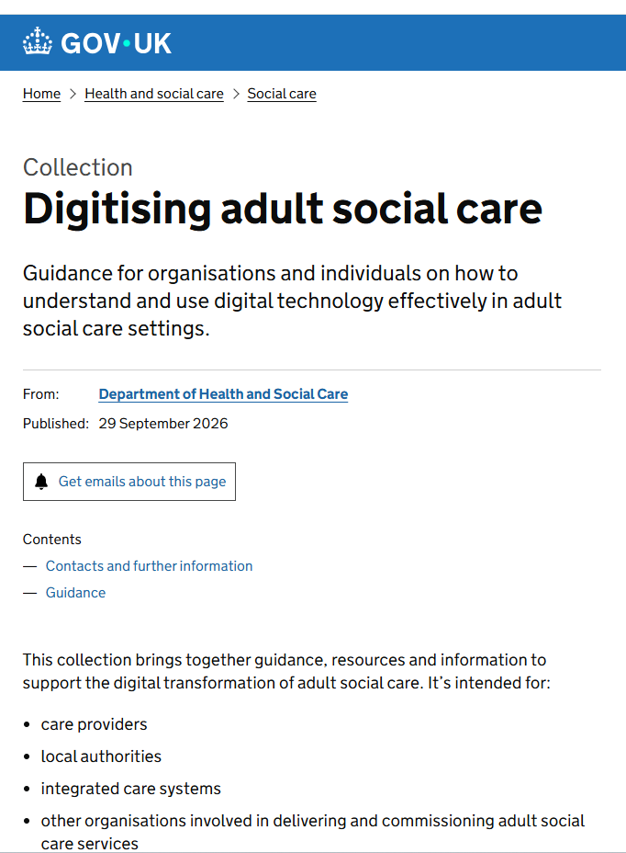
DHSC expectations around becoming a fully digitised care provider
A collection of refreshed resources, guidance and information published by DHSC
Lays out their expectation around all providers being 'fully digitised';
  Using an assured solutions Digital Social Care Record
  Meeting 'Standards Met' level on the Data Security and Protection Toolkit
'Using AI in Adult Social Care' - are you using AI safely and ethically in your organisation? A useful update and can be used to review your organisations use of AI and for staff training

Slide 30


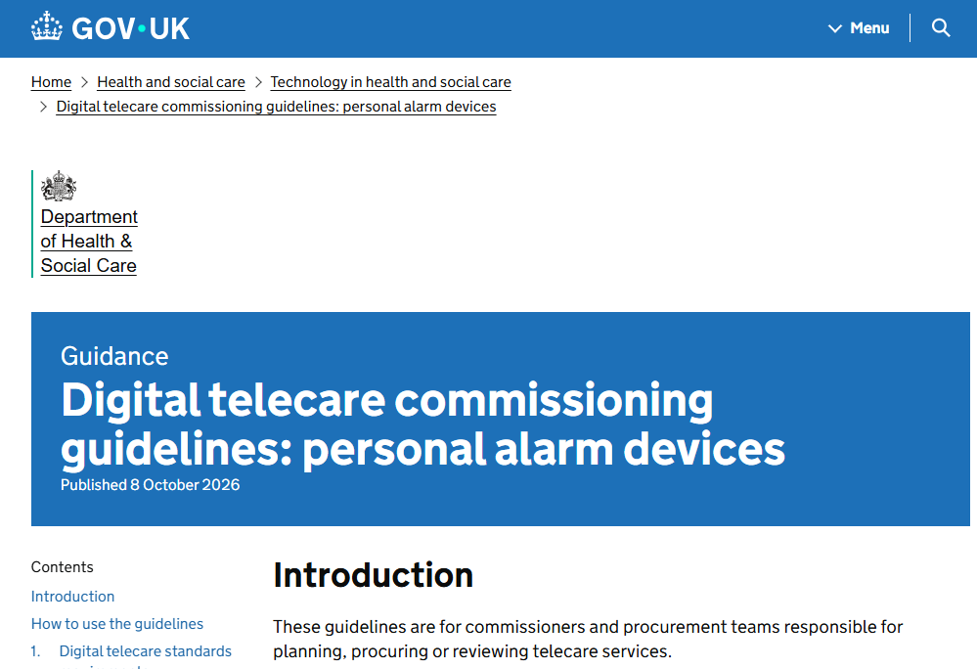
New DHSC telecare publications
A new suite of resources to support organisations involved in telecare commissioning, procurement and service delivery.
The publications have been developed to support the adult social care sector's transition from analogue to digital telecare services and to help ensure services remain safe, resilient and reliable for people who depend on them.
They set out technical and service requirements to help commissioners procure safe, resilient and reliable digital telecare services for:
  alarm receiving centres
  grouped living arrangements such as sheltered and supported housing schemes
  personal alarms for people living in the community
The requirements cover:
  digital telecare standards and interoperability
  connectivity and resilience
  service management and supplier assurance
  cyber security and data protection
  access to operational and performance data

Slide 31

Supporting digitisation of Adult Social Care – check out NCF's Digital Learning Training programmes
Digital Leadership Programme
Care Technologist Programme
Lead digital change across your organisation
Could you be your organisation's first, or next Care Technologist?
WHO IT IS FOR
WHO IT IS FOR
Adult Social Care Managers, Senior Leaders and colleagues responsible for leading digital change and supporting their teams.
Care staff, managers, digital champions and anyone curious about how technology can improve people’s lives.
WHAT IT BUILDS
WHAT IT BUILDS
Confidence to make informed technology decisions, overcome adoption barriers and keep people at the centre of change.
Practical skills to explore care technology, involve people in decisions and choose solutions matched to the individual's preferences
CORE FOCUS
CORE FOCUS
Digital basics, including safe and ethical use of AI in ASC • Being a digital leader Data & cyber security governance • Taking your workforce with you
Person-led practice • The tech toolkit
Ethics, safety & accessibility • Leadership & impact
NEXT COHORT
NEXT COHORT
17th, 24th Nov, 1st and 8th Dec 20026
20th, 27th Jan, 3rd, 10th and 17th Feb 2027
COST AND SUPPORT
COST
£575 + VAT per person | £525 reimbursement available to eligible participants through LDSS
£595 + VAT per person
Notes:
Use this slide to present the programmes as complementary: Digital Leadership supports organisational adoption; Care Technologist supports person-centred application. Costs shown exclude VAT. Digital Leadership participants may be eligible for £525 reimbursement from the ASC Learning and Development Support Service.

Slide 32


Slide 33


KEEP IN TOUCH!
Twitter: @vicrayner | @NCFCareForum
Email: vic.rayner@nationalcareforum.org.uk
Website: www.nationalcareforum.org.uk

