Slide 1

Care Leaders Network Meeting
27th January 2026

Slide 2
Agenda
Welcome and introductions – New Year Updates in the Sector
General BCA Updates, including, Care Awards Nominations and other local updates
Angie McNally, OACP – DSPT update including free support to Berkshire providers
Work Experience for T-Level Health & Social Care Students
Break
Alex Bayliss, AEB Social Care – Safeguarding, the Mental Capacity Act and DoLs
AOB

Slide 3
General updates
Are there any challenges affecting your service at the moment?

Slide 4





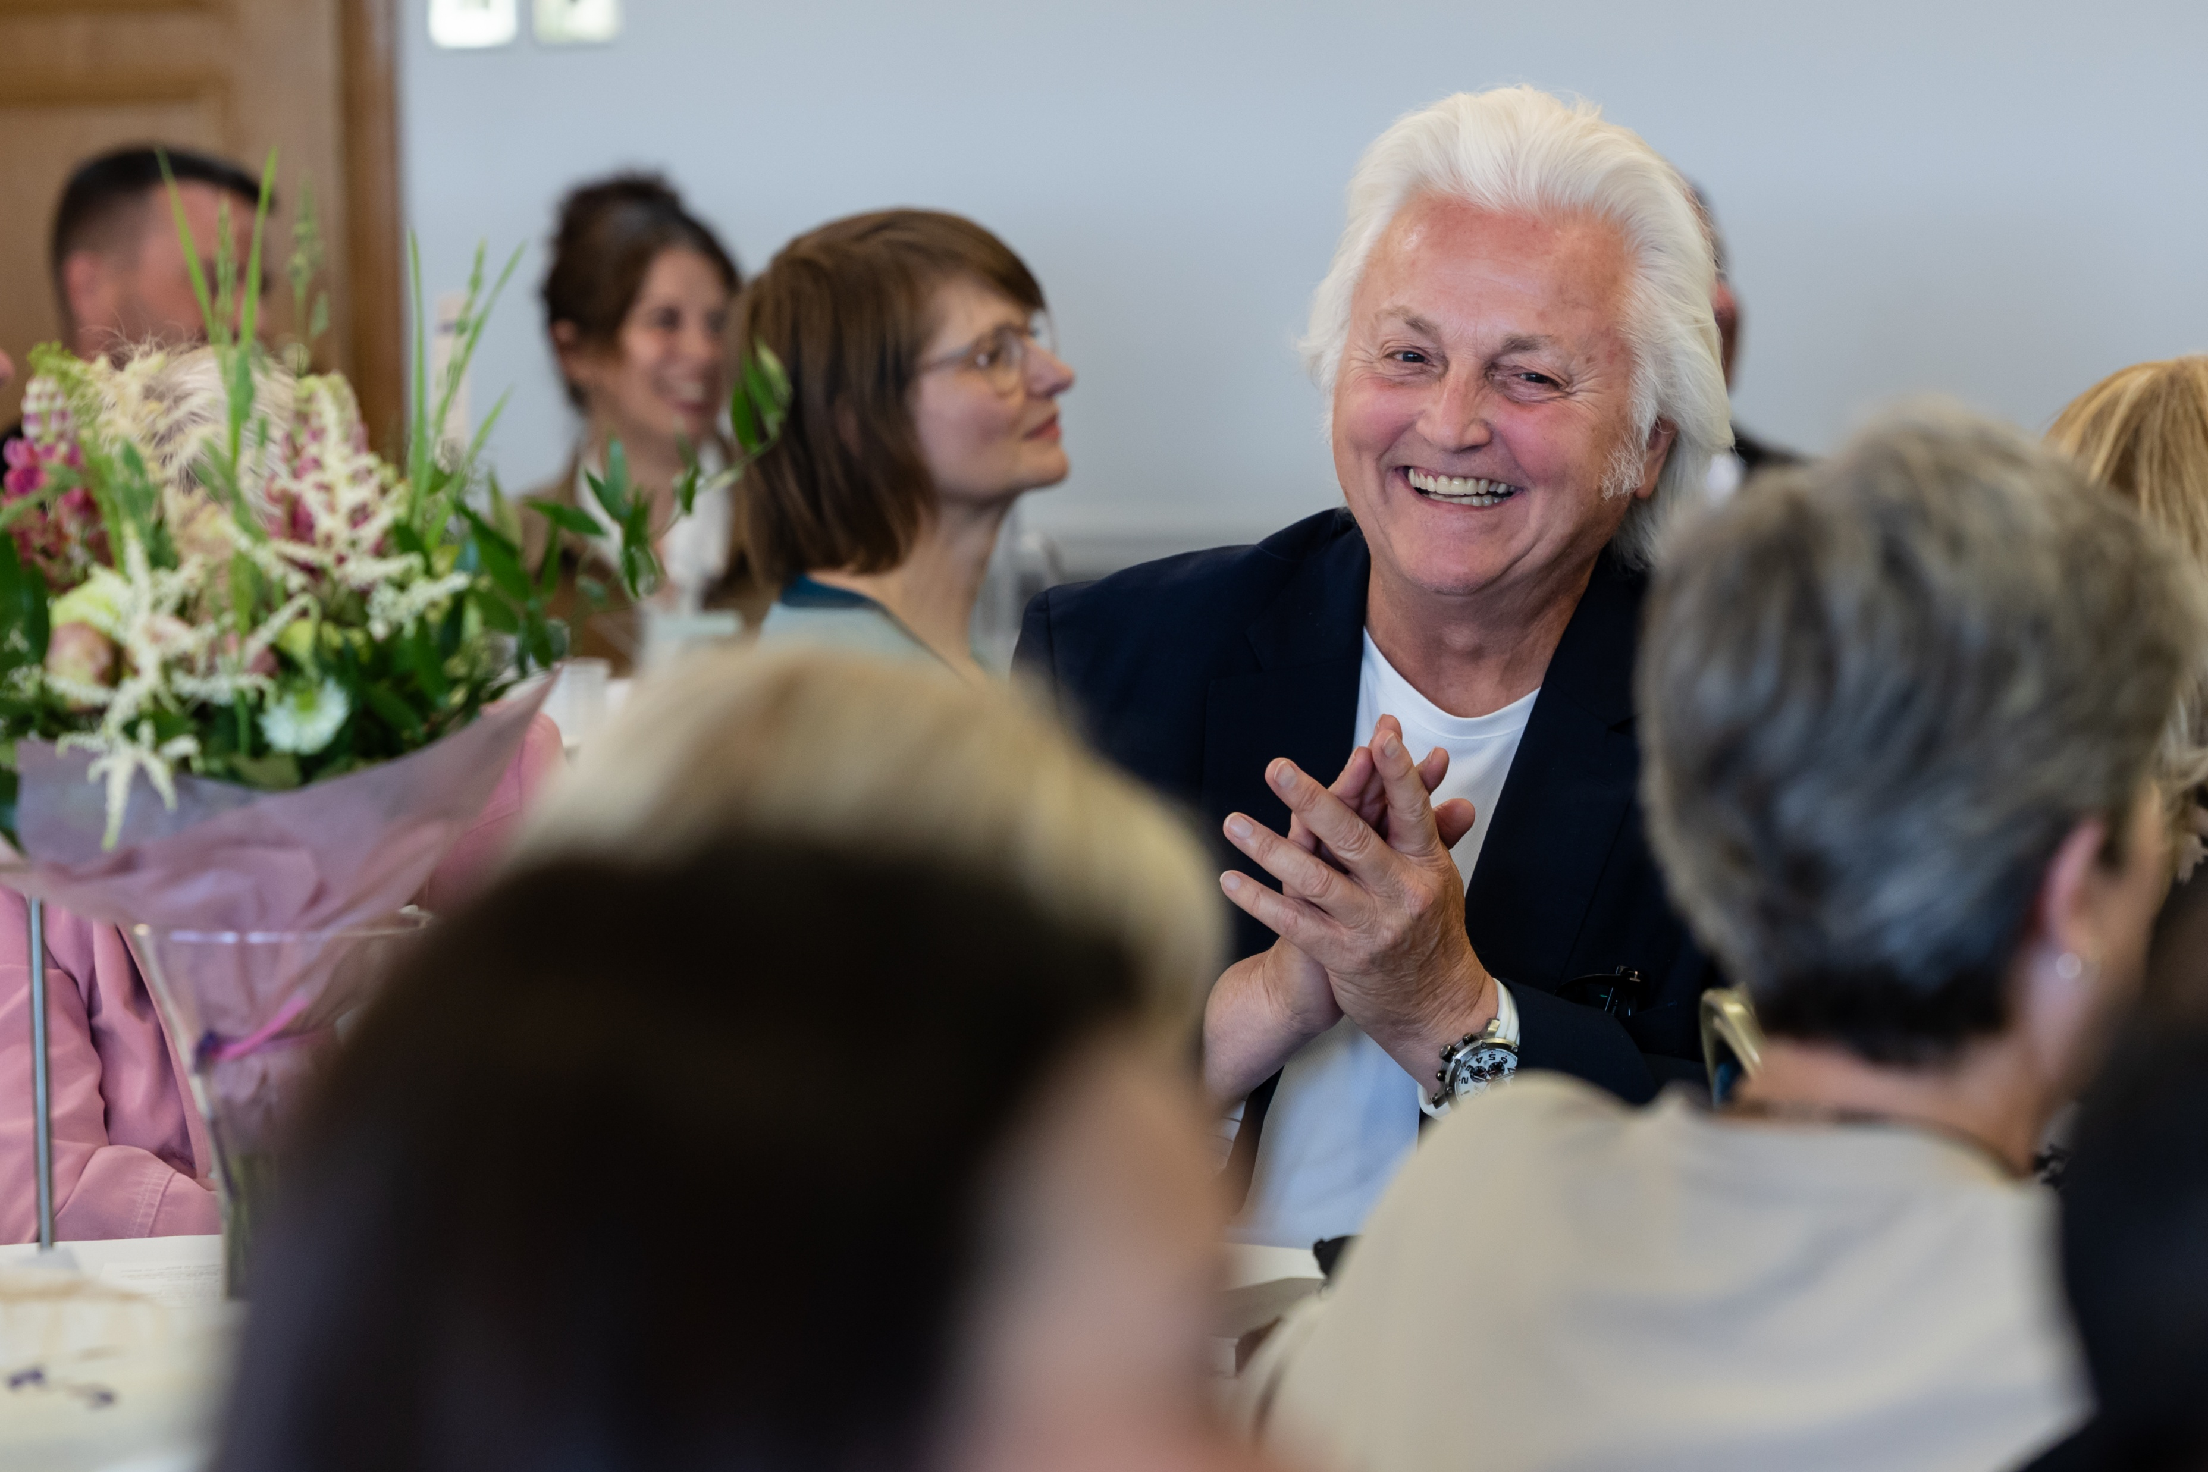
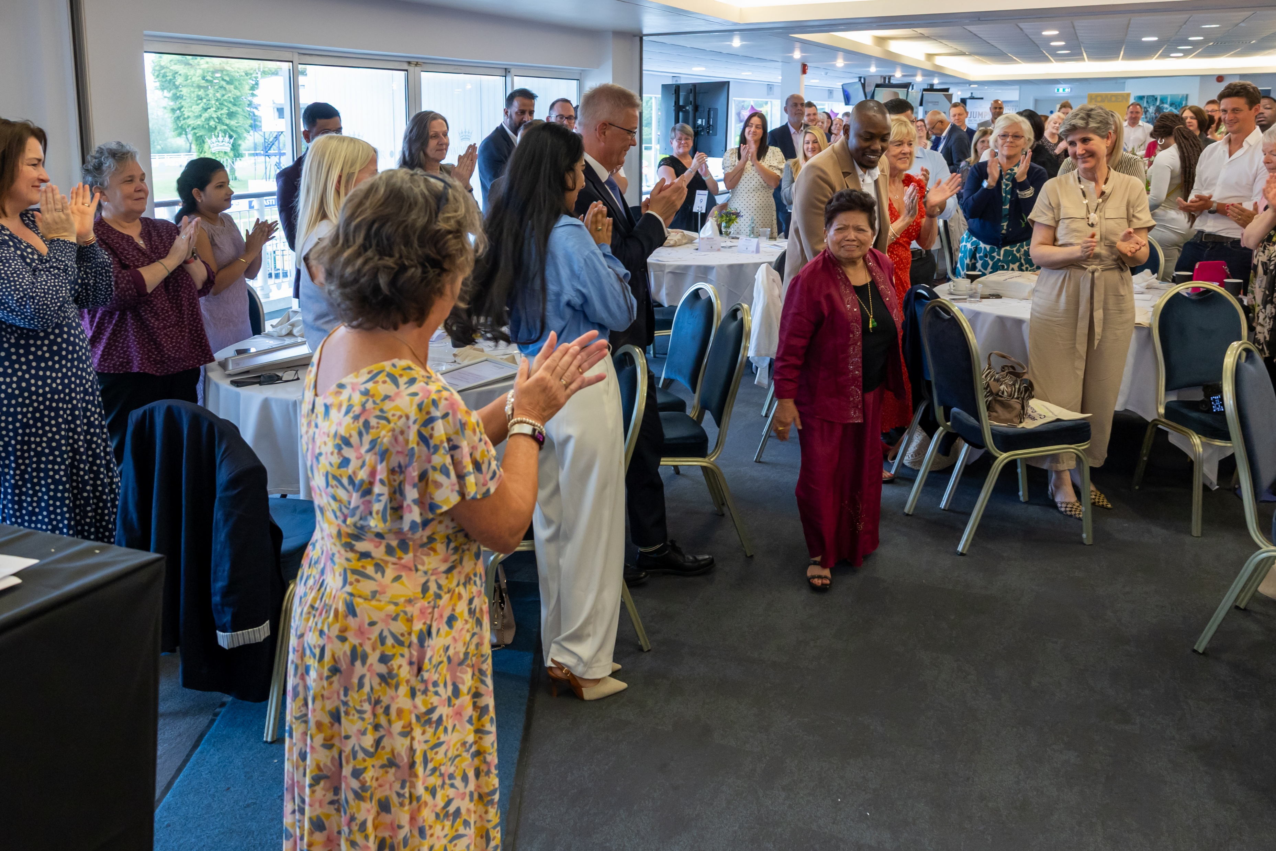
Deadline extended to Friday 27th February 2026

Slide 5
Frimley ICB upcoming Training Schedule
There are a wide range of online training courses available and details will be in the newsletter and on the website. Topics include
  Physical Health
  End of Life
  Mental Health
  Physiotherapy based training
  These courses are all free to East Berkshire Care Homes

Slide 6
Future Training
We are in the process of planning this year’s training schedule. If there is a particular topic that you would like us to cover please let us know.
We are hoping to invite Tim Dallinger back for another day of CQC training

Slide 7

International Recruitment
Displaced Workers
Displaced workers available for work
Grants available up to £6k
All candidate are pre-screened and suitable for care work
If you would like any more information, please contact us:
internationalrecruitment@berkscare.co.uk

Slide 8
DPST update Angie McNally

Slide 9
Work Experience Opportunities
Recent changes to T-Levels mean that students are looking for longer placements
We are looking for Care Ambassadors to come to a meeting at Bracknell and Wokingham College and Reading College to attract students to social care
Bracknell and Wokingham College are looking for placements for a specific group of students – 1 day per week for 6 weeks

Slide 10
Alex Bayliss – AEB Social Care

Slide 11
BCA Executive Membership
From just £260 per year, Executive Members gain direct access to expert advice, hands-on support with CQC inspections and safeguarding, discounted training and awards, and the opportunity to shape the future of BCA by standing for the board. You’ll also receive RN validation advice, use of the BCA logo, and recognition through a framed membership certificate.
‘BCA Executive membership is worth every penny. There is always someone, with expert knowledge of the sector, to reach out to for guidance, support and advice.
The additional benefits of discounts for training and events are a bonus. We would not hesitate in recommending Executive membership of BCA’.
Janet Elliot, Support Manager for ANW Care Homes
“Backed by strong partnerships across the Thames Valley and the South East, Executive Membership strengthens your voice — locally and nationally — while giving you practical support when you need it most”.

Slide 12
Any other business

Slide 13
Dates for Future Meetings
24th March
19th May
30th June

Slide 14
Social Media and keeping in touch
We are on LinkedIn, Facebook and Twitter and are posting regular updates of things that may be of interest – if you have any good news to share please forward to Sue or Louise
We also have a ‘What’s App’ group. If you would like to join please speak to Sue or Louise.
All resources and general information will be on the BCA website www.berkscare.co.uk – including CLN Slides and Newsletters
If you would like anyone at your organisation to be added to the mailing list let us know
Notes:
Almost 90 nominations!
Still need more nominations for Care home Worker, Support worker in an LD Service, Nurse, Chef
Deadline this Friday 22nd April

Slide 15



Social Media
We are on LinkedIn, Facebook and X
Please feel free to follow us – QR codes can be found on tables:
Berkshire Care Association
Berkshire Care Association
(there is a new page)
@berkscare
If you have a good news story or something you would like us to share please tag us or send to louise.good@berkscare.co.uk

