Slide 1
OneBerkshire
Community Nursing Serving Berkshire communities
Slough, Windsor, Maidenhead, Bracknell and Ascot, Wokingham, Reading and West Berks

Slide 2
The Community Nursing Service provides nursing treatment and care to patients that meet the home needs assessment for the population of Berkshire
We work closely with all service to provide high quality nursing care to support patients' individual needs
We provide care for patients with a wide range of medical and complex conditions, as well as increasing mental health, social and safeguarding needs. We aim whenever possible, to promote independence and encourage self-care.
7 days a week
365 days a year
Core service hours 07:00-19:00
Out of hours 19:00-07:00
Notes:
This is an overview of the District Nursing service.
24 hours a day split between Core and OOH.

Slide 3
Community Nursing Service
Berkshire
(Obiageli Okongwu – Head of Service)
Sonia Durrani
Service Lead
Kerry Wilson
Service Lead
Slough
Karen Archer
Community Manager
Windsor and Maidenhead
Saiyad Allymamod
Community Manager
Reading
Samantha McEndoo Community Manager
Wokingham
Mark Phillips
Community Manager
Bracknell
Anne Gates
Community Manager
West Berks
Tracy Clifton
Community Manager
Notes:
This is the hierarchy of our service.

Slide 4
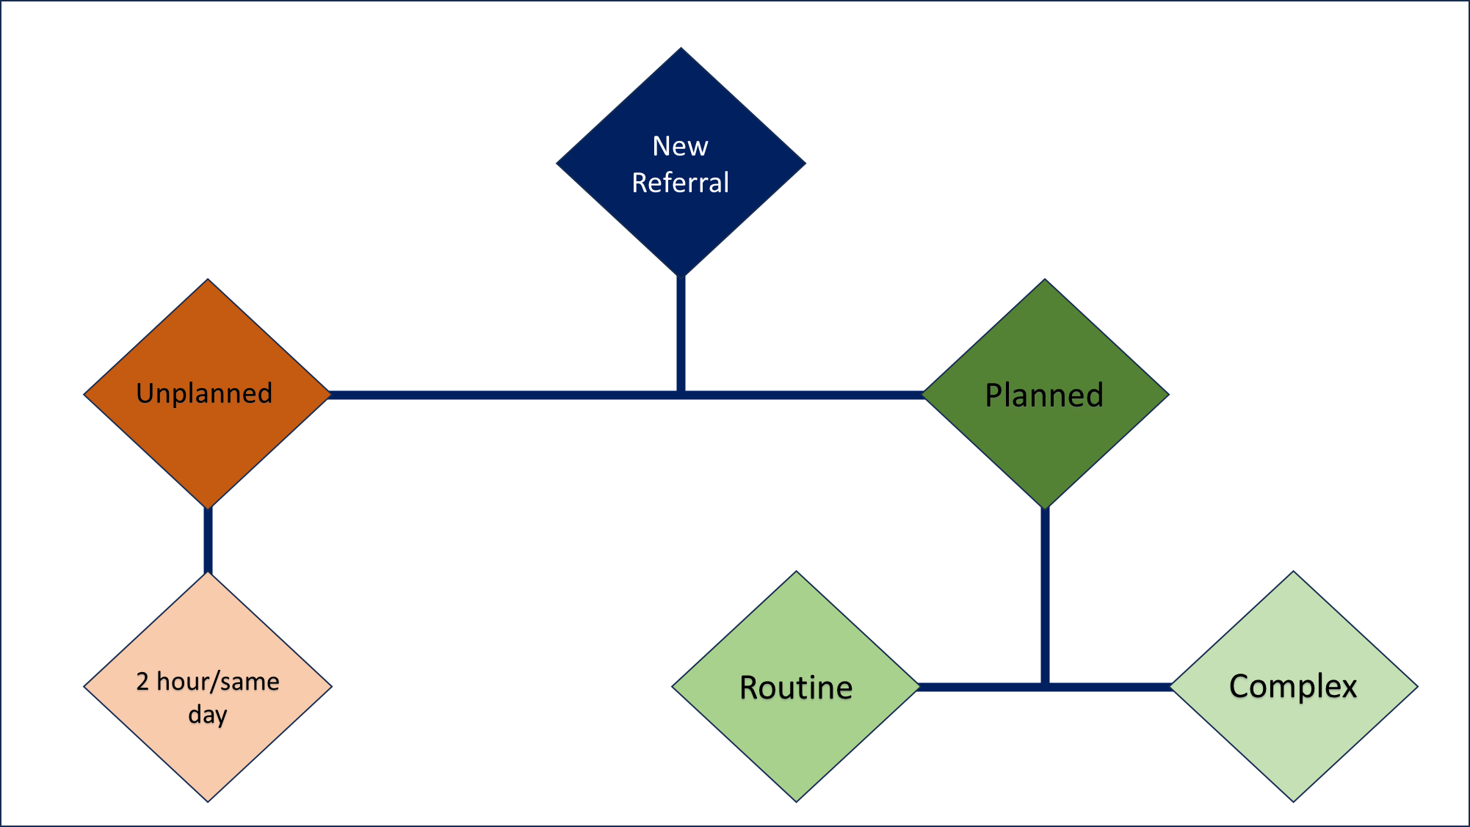
Notes:
Flow of patient needs.
Via a Single Point of Access
Complex patients assessed by a community matron/ANP.

Slide 5
Our vision is to provide an integrated community nursing service that supports the needs of the Berkshire patient who needs a range of support from the simple to the complex needs.
A needs-based approach to care delivery with a defined triage to assess the skill set and competences required to provide care on referral to our service.
Right Care, Right Person, Right Place.
Notes:
Introducing our new vision for community nursing.
Community Matrons and Community Nursing teams work together to support the CN workforce and manage complex patients in the community.

Slide 6
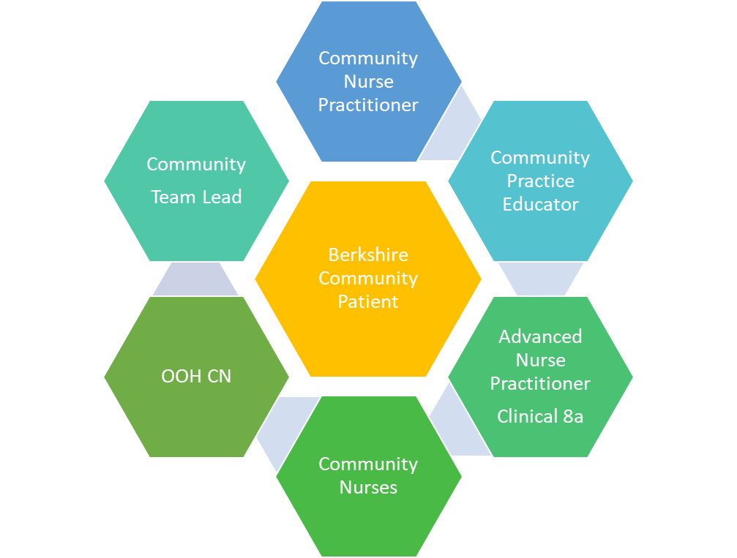
Community Nurse managers
Clinical leads
District Nursing Sisters (SPQ trained)
Community Nursing Sisters
Community Staff Nurses
Nurse Associates
Health care assistants
Wound care specialist nurses
Phlebotomists
Administrators
Dedicated Triage
Team Leads
Continence Assessors
The Team
Notes:
Our Community Nursing team

Slide 7
Our core pathways
End of life/Palliative care
Assessment and care planning
Hi Tech care
Medication administration
Specialist technical care
Catheter and continence assessments
Tissue viability
Non urgent routine venepuncture, Administration of IVABX, care of central and midlines, Disconnection of chemotherapy line post treatment
Supporting and teaching of Insulin administration, EOL Medication for symptom control, Subcutaneous/ Intramuscular injection,
Chest / Breast / Rocket / Pigtail / Nephrostomy drains
pressure area prevention and pressure ulcer management, leg care and wound management, trauma and surgical wounds, fungating wounds
Symptom management, Health promotion, support for carers and families. Interventions – Syringe Driver/Just in Medication administration.
Administrative & clinical triage, Signposting to appropriate service Accessing relevant information, Holistic assessment and care planning, Continuing health care assessments for patients on an active DN caseload.
Male and female urethral/suprapubic catheterisation, Bowel management: assessment & management for complex patients only

Slide 8
Integrated working and onward referrals
Local Authority
Heart Function
AIRS
Diabetic nurse specialists
Palliative care
UCR & Virtual Frailty wards
ARC
Local access point (LAP)
Community Nurse Practitioners
Primary care services
Community Inpatient wards
Acute hospital
Notes:
Some of the other disciplines we work alongside.

Slide 9
Referral Criteria
Over 18 years old
Registered with a Berkshire GP
Adults requiring care must be in the home setting following a home-based needs assessment (housebound). This can be on a temporary basis.
Consent for Community Nursing contact

Slide 10
To make a referral complete the District Nursing referral form on DXS and send to
For Slough, Windsor, Maidenhead, and Bracknell
integratedhub@berkshire.nhs.uk
HUB number 0300 365 1234
For Reading – ReadingCommunityNursingTriage@berkshire.nhs.uk
Call 0300 365 3000
For West Berks - Email NewburyUrgentCare@berkshire.nhs.uk
Call 0118 904 6505
For Wokingham – Email - WokinghamTriage@berkshire.nhs.uk
Call 0118 904 6700
Please ensure you leave a name and contactable number on the referral form should triage require any further information

Slide 11
Working together – Moving forward
Collaborative working – improved communication.
MDT discussions.
Clear referral method.
Alternative practice experience for staff.

Slide 12

Thank you for your time
Any questions?

