Slide 1

Care Leaders Network
4th June 2024

Slide 2
Agenda
Welcome and introductions
General updates/ anything to share
Croner-i – Rahim Jospeh-Garrison and Emily Small
Michelle Morley, Lead Manual Handling Trainer at Gravitas: Interpreting the MHRA Guidance Bed rails: management and safe use
Hannah Flower, Clinical Operations Manager SCAS – Question and Answer session
Training Opportunities
AOB/next meetings
Next Meeting TBC in Person

Slide 3
General updates – anything to share?

Slide 4



EveryStoryMatters.co.uk

Slide 5
Rahim Joseph-Garrison and Emily Small
Croner-i

Slide 6
Michelle Morley
Lead Manual Handling Trainer at Gravitas: Interpreting the MHRA Guidance Bed rails: management and safe use

Slide 8

Hannah Flower
South Central Ambulance Service (SCAS) Q+A session with Hannah Flower, Clinical Operations Manager for SCAS

Slide 9
Training Opportunities
The following are upcoming training that you may find useful:
Mental Capacity and Adult Safeguarding Masterclass delivered by Alex Bayliss – Adult Safeguarding and MCA Expert EventBrite Booking Link is available on the website
Documentation – Learning from case studies
IHSCM: Deputies Effective Leadership Programme
If there are any other topics that you would like us to deliver then please let us know

Slide 10
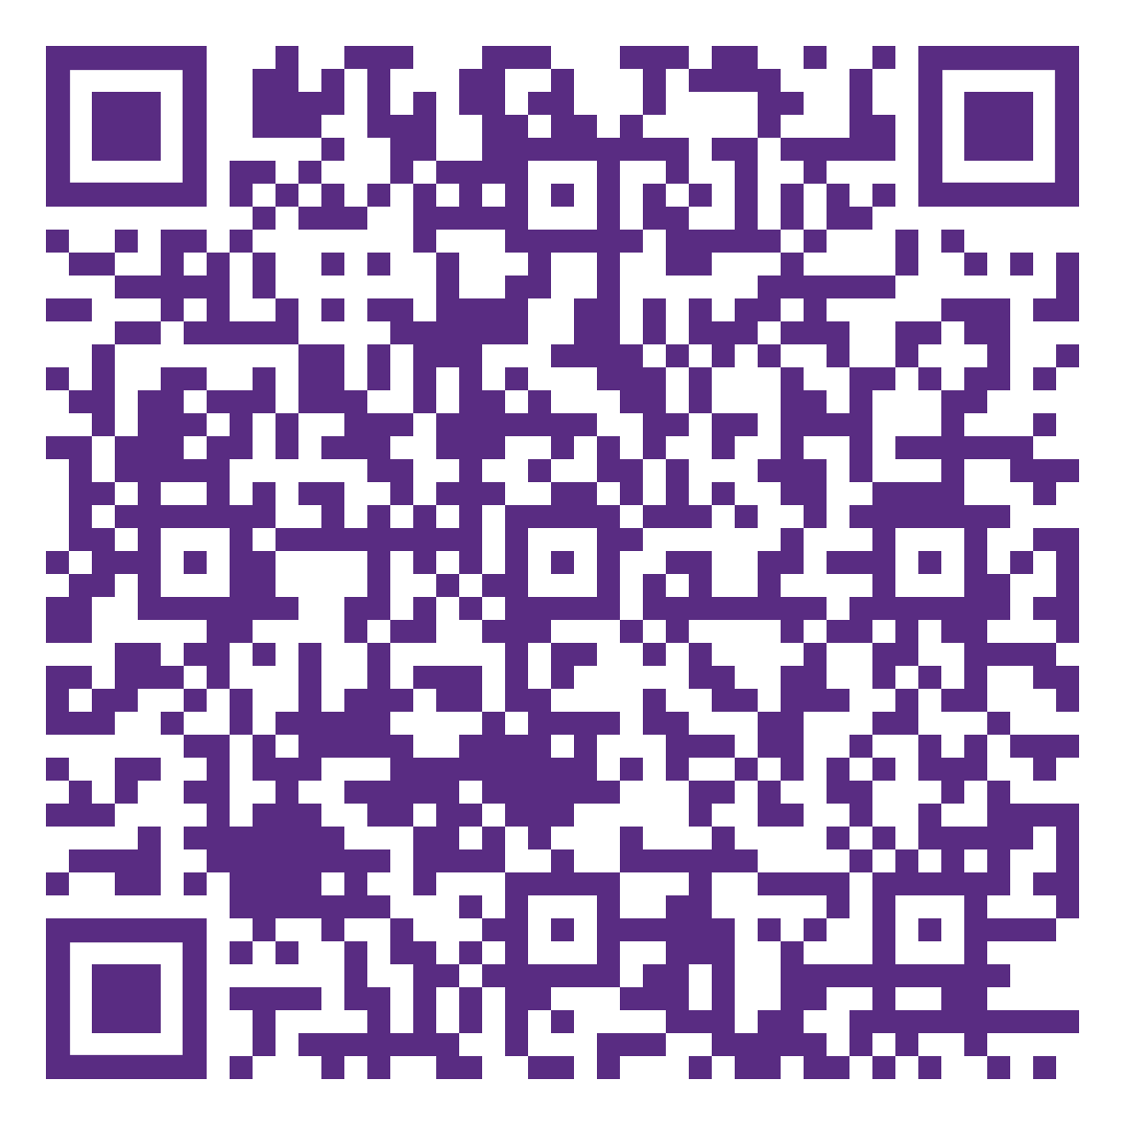
Mental Capacity and Adult Safeguarding Masterclass with Alex Bayliss
The session will cover the following topics.
Top tips for compliance with the Care Act Safeguarding requirements and the Mental Capacity Act
Learning from Adult Safeguarding reviews
Working in partnership with statutory agencies including the limits of what you can reasonably be expected to do as a care provider.
Learning from Ombudsman investigation relating to Safeguarding and Mental Capacity
Evidencing outstanding practice
Delegates will also have the opportunity to discuss and seek advice
17th September 2024, 2-5pm
St Michael’s, Ascot Priory
£30 for members, £20 for Executive members
Booking link EventBrite Booking Link

Slide 11

IHSCM Deputies Training

Slide 12
IHSCM Deputies Training
The course is aimed at deputies and/or aspiring leaders looking at developing their leadership skills and there are 4 1 hour modules:
Me, myself and I (12th September)
Developing Your Team (19th September)
Leadership Excellence (26th September)
Managing Change & Preparing to Lead (3rd October)
Each course runs for 1 hour from 1.30pm to 2.30pm on Thursdays afternoons and are FREE to all Berkshire Care Association members (any CQC registered provider in Berkshire). If you need the registration code for your free IHSCM membership please let us know and we can send it to you.

Slide 13
Social Media and keeping in touch
We are on LinkedIn, Facebook and Twitter and are posting regular updates of things that may be of interest – if you have any good news to share please forward to Sue or Louise
We also have a ‘What’s App’ group. If you would like to join please speak to Sue or Louise.
All resources and general information will be on the BCA website www.berkscare.co.uk – including CLN Slides and Newsletters
If you would like anyone at your organisation to be added to the mailing list let us know
Notes:
Almost 90 nominations!
Still need more nominations for Care home Worker, Support worker in an LD Service, Nurse, Chef
Deadline this Friday 22nd April

Slide 14



Social Media
We are on LinkedIn, Facebook and X
Please feel free to follow us – QR codes can be found on tables:
Berkshire Care Association
Berkshire Care Association
(there is a new page)
@berkscare
If you have a good news story or something you would like us to share please tag us or send to louise.good@berkscare.co.uk

Slide 15
Next Meeting
TBC
In person

Slide 16
Any other business or Questions?

