Slide 1

Care Leaders Network
16th April 2024

Slide 2
Agenda
Welcome and introductions
General updates/ anything to share
  Care Homes
  Home Care
  Learning Disability
International recruitment & police visit to care home
BCA Care Awards 2024—Celebrating Excellence in Care
Keeping in Touch
Sharon Gallagher – Senior business development manager for Person Centred Software (PCS)
  Connected Care Platform
  Digital care planning & Emar
IHSCM Training day – 8th May
AOB/next meetings
Next Meeting 4th June

Slide 3
General updates – anything to share?

Slide 4
International Recruitment
Lots of advice, Information and signposting is available on the BCA website: www.berkscare.co.uk
There is also a FREE legal helpline and workshops that International recruits can attend
Recent police visit and advice given

Slide 5

So excited to notify our short-listed nominees
Looking forward to celebrating with everyone on the 25th
Those that didn’t send in any nominations – make sure you do next year!!
Notes:
Almost 90 nominations!
Still need more nominations for Care home Worker, Support worker in an LD Service, Nurse, Chef
Deadline this Friday 22nd April

Slide 6
Social Media and keeping in touch
We are trying to keep up to date with all social media
Please comment/ask questions on our FB page.
We also have a ‘What’s App’ group. If you would like to join please speak to Sue or Louise.
And we are on Twitter
Newsletter much shorter and will be sent monthly instead of weekly. All resources and general information will be on the BCA website www.berkscare.co.uk
Notes:
Almost 90 nominations!
Still need more nominations for Care home Worker, Support worker in an LD Service, Nurse, Chef
Deadline this Friday 22nd April

Slide 7



Social Media
We are on LinkedIn, Facebook and X
Please feel free to follow us – QR codes can be found on tables:
Berkshire Care Association
Berkshire Care Association
(there is a new page)
@berkscare
If you have a good news story or something you would like us to share please tag us or send to louise.good@berkscare.co.uk

Slide 8
Sharon Gallagher
Senior Business Development Manager
Person Centred Software
Connected Care platform
Digital care planning
EMar

Slide 9
Capacity Tracker
Workforce Development fund

Slide 10

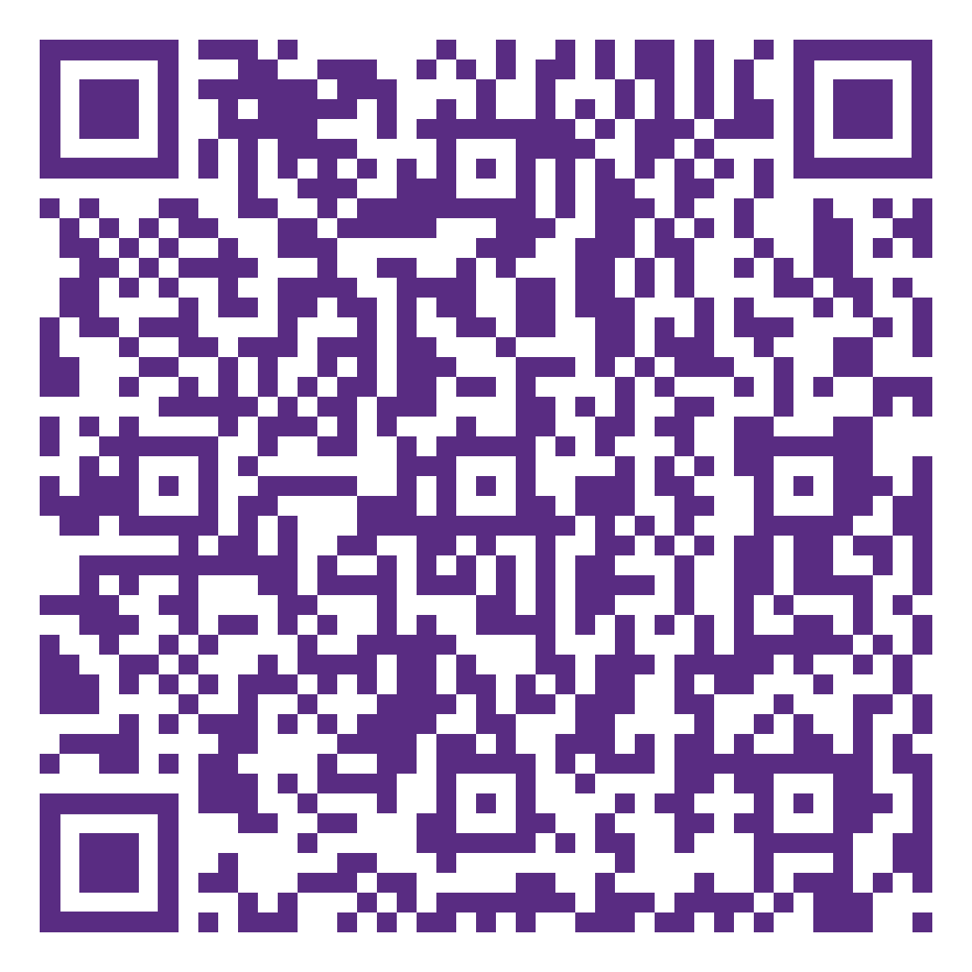
Notes:
Details can be found on the members area of the website under upcoming events
£20 fee to cover lunch and refreshments
Flyers here to collect
All BCA members (exec and non exec) entitled to free membership with IHSCM

Slide 11
Next Meeting
4th June 2024 2.30pm
In person

Slide 12
Any other business or Questions?

