Slide 1

Care Leaders Network
19th March 2024

Slide 2
Agenda
Welcome and introductions
General updates/ anything to share
BCA Care Awards 2024—Celebrating Excellence in Care
IHSCM Training day – 8th May
Social Media details
AOB/next meetings
Next Meeting 16th April

Slide 3
General updates – anything to share?
Capacity Tracker
Equipment and consumable review
Accessibility to TVNs, CPNs,/psychiatry, GPs, District Nursing, palliative care – easy or problematic?
Impact of MDTs?

Slide 4


Nominations close this Friday!
Notes:
Almost 90 nominations!
Still need more nominations for Care home Worker, Support worker in an LD Service, Nurse, Chef
Deadline this Friday 22nd April

Slide 5

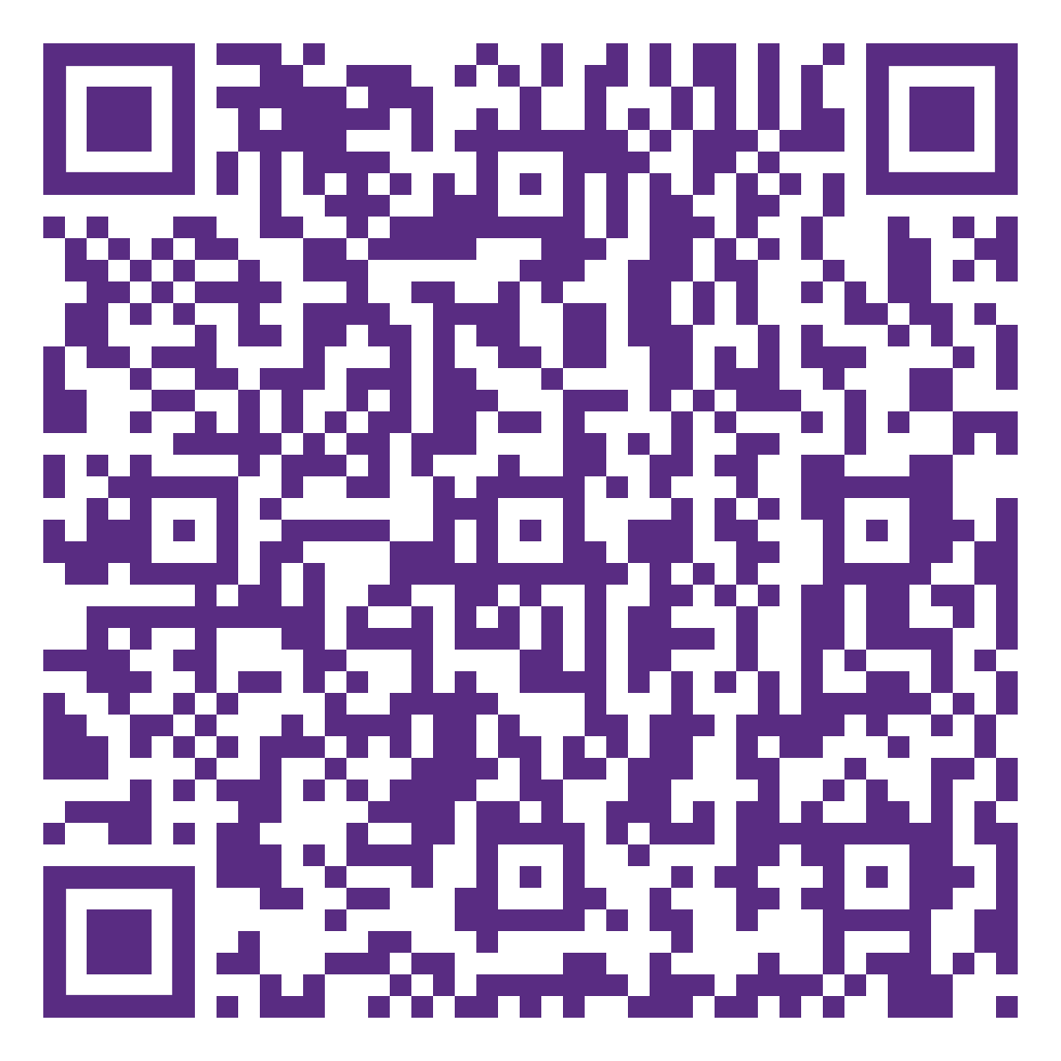
Wednesday 8th May
10am to 4pm
IHSCM is free to join for all BCA members
£20 for refreshments
Notes:
Details can be found on the members area of the website under upcoming events
£20 fee to cover lunch and refreshments
Flyers here to collect
All BCA members (exec and non exec) entitled to free membership with IHSCM

Slide 6



To join the whatsapp group text 07942 743185
We are on LinkedIn, Facebook and X
Please feel free to follow us – QR codes can be found on tables:
Social Media
Berkshire Care Association
Berkshire Care Association
(there is a new page)
@berkscare

Slide 7
Next Meeting
16th April 2024 2.30pm
Would people prefer in person or Zoom?

Slide 8
Any other business or Questions?

Slide 9
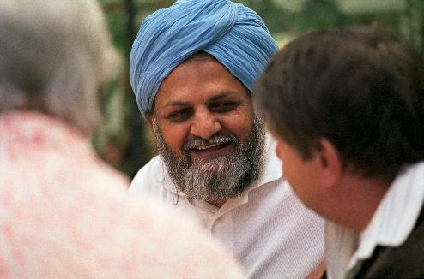
Update from CQC
John Clifford
ASC Senior Specialist
Berkshire Care Association Care Leaders Network 19 March 2024
Notes:
9

Slide 10
Topics
Single Assessment Framework
Our new teams
Digital Social Care records

Slide 11

Why we’re changing?
To have a greater focus on care across local areas or systems
To use our new regulatory powers effectively to improve people’s care
To make our regulation less complex and more efficient
To regulate in a smarter way
To work better with the sector
as it changes and recovers
Notes:
Our strategy sets out an ambitious future that will ensure we keep delivering our purpose. To deliver that strategy effectively, we need to change how we work.
We know that it’s important to understand the quality of care in a local area or system in order to improve it and keep people safe. It’s often when people move between care services that they fall through the cracks and have a poorer experience.
We now have new regulatory powers that allow us to offer the public and Parliament a meaningful and independent view on care at a system and local authority level. We need to make sure that we use our new and existing powers effectively to improve people’s care and deliver our strategy, so we’re changing how we work and how we regulate to do this.
Before the pandemic, we were clear that we needed a way to look at the quality of care across health and care systems. We knew our regulation needed to be less complex and more efficient. We wanted to regulate in a smarter way – being able to adapt and respond to risk, uncertainty and demand, with data and information at our fingertips. The pandemic has highlighted the areas that we already knew needed to change.
Now, as we emerge from the pandemic, the health and care sector itself has changed and is struggling to recover along with new challenges and risks. We want to work with the sector, as an effective partner. We simply can’t stand still – we must transform to adapt to the changing nature of health and care provision and the changing needs of people who use services.
11

Slide 12
Our transformation
Our transformation and new approach will build on 3 key pillars:
  Our strategy
  Our risk-based approach during the pandemic
  Our new statutory roles
Underpinned by the data we gather, we will use our new and existing powers to improve people’s care.
We’re changing how we work and how we regulate
Notes:
12

Slide 13
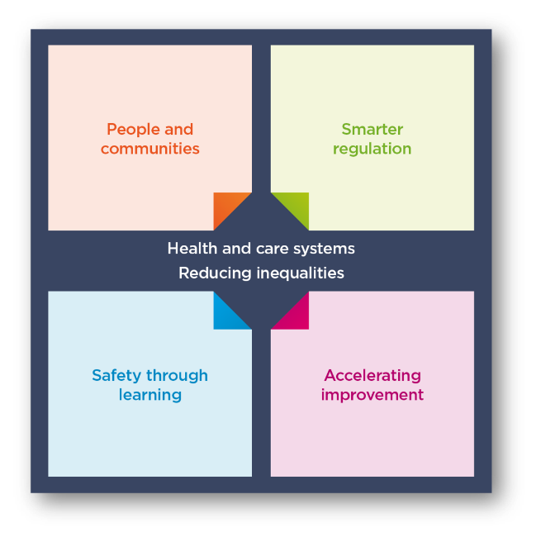
Our strategy
Our overall aim and focus is on tackling inequalities
and driving improvement
Notes:
Our strategy published in May 2021 is a strategy for the changing world of health and social care. We are being ambitious.
The health and social care landscape has changed drastically since 2016, when our previous strategy was published. Changes in the health and social care sector have been accelerated by the pandemic, increasing the needs of those who access health and social care services and placing additional challenges on service providers to meet them.
Our role as the regulator of health and social care in England has also been greatly affected by the pandemic, affecting our ability to inspect all services and provide the necessary assurance to the public of their safety.
We’re on a journey to change how we regulate to improve care for everyone.
Our strategy strengthens our commitment to deliver our purpose: to ensure health and care services provide people with safe, effective, compassionate, high-quality care and to encourage those services to improve. Our strategy is purposefully ambitious, and to implement it we will need to work closely with others to make it a reality. We’ll review this strategy regularly so we can adapt to changes and be prepared for what the future holds.
Our strategic themes:
We’ll continue building the underpinning systems and structures, and making changes, to enable our strategy over the next two to three years, but full realisation of the strategy will take longer as we continuously learn and evolve, responding to changes in the world around us.
the four interlinked themes that will determine the changes we will make;
People and communities
Smarter regulation
Safety through learning
Accelerating improvement
All of this comes back to our core ambition of tackling inequalities. We’re pushing for equality of access, experiences and outcomes from health and
social care services
13

Slide 14

Tackling inequalities
Our strategy has a core ambition of tackling inequalities.
The pandemic exacerbated inequalities - people who were less likely to receive good care before the pandemic are often the same groups disproportionally affected by COVID-19.
We’re pushing for equality of access, experiences and outcomes from health and social care services
Notes:
14

Slide 15
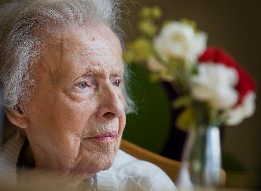
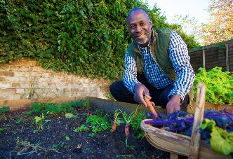
Improving outcomes for people and reducing inequalities
Our new responsibilities to assess local authorities and integrated care systems under the Health and Care Act will support us to deliver the objectives and ambition of our strategy.
They will allow us to look at how effectively care is provided in a local system, and how it is improving outcomes for people and reducing inequalities in their care.
This will transform how we bring together a view of quality across a local area, put people at the centre of care and help drive improvement in care.
Notes:
The final version of the Act:
Gives CQC a duty to independently review and assess how Local Authorities are delivering their Care Act functions under Part 1.
Creates new powers for CQC to have oversight of Integrated Care Systems (ICSs), putting three key themes for assessment on the face of the Bill – Leadership, integration and quality and safety.
Introduces a requirement for all health and social care providers who carry out regulated activities to ensure that their staff receive specific training appropriate to their role on learning disabilities and autism. The Secretary of State (SofS) is also required to produce a Code of Practice with regards to training on learning disability and autism.
Creates a duty for CQC to enforce the NHS food and drink standards. The Bill imposes requirements on NHS hospitals in connection with food or drink provided or made available to any person on hospital premises in England that are used in connection with the carrying on of a regulated activity. Further regulations will be made which will specify the nutritional standards or requirements which are to be complied with.
New powers –
We now have new powers to oversee local authorities and integrated care systems under the Health and Care Bill.
These will support us to deliver the objectives in our strategy by allowing us to look more effectively at how the care provided in a local system is improving outcomes for people and reducing inequalities in their care.
We’ve engaged extensively over the last year on how we’ll do this, including two large workshops with around 400 representatives from across the country and establishing an expert advisory group to provide dedicated input.
This will be transformative in how we bring together a view of quality across a local area, put people at the centre and help drive improvement in care.
15

Slide 16

New responsibilities
CQC has new responsibilities:
  The Health and Care Act gives CQC
  a role in reviewing integrated care systems
  It also gives CQC a duty to assess how local authorities are meeting their social care duties under part 1 of the Care Act
These will allow us to look more effectively at how care provided in a local system is improving outcomes and reducing inequalities.
We’ve engaged extensively on how we’ll do this. We want to bring together a view of quality across a local area and put people at the centre of driving improvement in care.
Notes:
The final version of the Act:
Gives CQC a duty to independently review and assess how Local Authorities are delivering their Care Act functions under Part 1.
Creates new powers for CQC to have oversight of Integrated Care Systems (ICSs), putting three key themes for assessment on the face of the Bill – Leadership, integration and quality and safety.
Introduces a requirement for all health and social care providers who carry out regulated activities to ensure that their staff receive specific training appropriate to their role on learning disabilities and autism. The Secretary of State (SofS) is also required to produce a Code of Practice with regards to training on learning disability and autism.
Creates a duty for CQC to enforce the NHS food and drink standards. The Bill imposes requirements on NHS hospitals in connection with food or drink provided or made available to any person on hospital premises in England that are used in connection with the carrying on of a regulated activity. Further regulations will be made which will specify the nutritional standards or requirements which are to be complied with.
New responsibilities –
We now have new powers to oversee local authorities and integrated care systems under the Health and Care Bill.
These will support us to deliver the objectives in our strategy by allowing us to look more effectively at how the care provided in a local system is improving outcomes for people and reducing inequalities in their care.
We’ve engaged extensively over the last year on how we’ll do this, including two large workshops with around 400 representatives from across the country and establishing an expert advisory group to provide dedicated input.
This will be transformative in how we bring together a view of quality across a local area, put people at the centre and help drive improvement in care.
16

Slide 17
What will change?
Our new approach has 4 main areas:
New technology – we’ll be able to harness what we hear from people using services through new data and insight skills and technology
New policy – we’ll use a single quality assessment framework for all service types and at all levels
New ways of organising – we’ll be working in multidisciplinary teams to make sure we can look at quality better across an area
New responsibilities – we’ll build on our previous activity looking at how services work together across a local area with new assessments of integrated care systems and local authorities
Notes:
New technology – we’ll be able to harness what we hear from people using services through new skills and technology for data and insight, supporting our colleagues to make decisions. This is coupled with a better experience for providers through our new online portal, to reduce burden and increase the quality of data we collect from them.
New policy – we’ll use a single quality assessment framework for all service types and at all levels, from registration through to provider assessments and assessments of integrated care systems (ICSs) and local authorities. This will be the basis for our judgements about quality.
New ways of working – we’ll be working in teams with a mix of expertise and experience of different health and social care sectors to make sure we can share specialist skills and knowledge about all sectors. This means bringing people together who have different perspectives to give us the best view of services across a local area.
New powers – we’ll build on our previous activity looking at how services work together across a local area with new powers to look at ICSs and local authorities, which will help to hold them to account and encourage improvement.
All of this will enable us to present a better view of the quality of care being delivered in health and care services and in local areas. It will be built on how people experience care and what matters to them. We will be able to better spot health inequalities and disparities between areas, so we can provide better information to partners to help improve care for everyone.
17

Slide 18

Our new online portal
We’ve created a new online portal for providers to interact with us in a simple and intuitive way.
This new portal will allow providers to:
share information easily with CQC,
including submitting notifications
register or apply to make changes to their
registration
manage their user accounts and easily
access information about their activity
Notes:
We’ve created a new online portal that will be simple and intuitive to enable providers to submit information to us. We want to make it easier for providers to work with us, so we’ll collect data in a more structured format. We will ask you to validate the information we hold and ask for the information we cannot get elsewhere and in a way that makes it easy to get right the first time – both for registration and assessment use.
Once fully launched, all providers will be able to:
register with CQC for the first time
submit notifications and share information
apply to make changes to their registration
manage their user accounts and contact preferences online access the registration data CQC holds about them and update this as required, in time, we’ll also provide benchmarking information too
18

Slide 19

Benefits of the portal and other digital services
A smoother, more functional experience for providers to interact with us
Better data to look at local areas and respond more effectively
Notes:
The new portal is one part of delivering a wide range of improved digital services that will deliver:
A Smoother experience when providing information to CQC
Less time spent and increased consistency, part of our tech but also we'll have that consistency through our single assessment framework
instant access to important information and ultimately we'll be able to have less time gone from inspection to report publication, which means information gets to public/providers more quickly
Clear history of submission and activity
Later on you'll be able to see benchmarking, which will help you to better plan and know how you are performing
19

Slide 20

Outcome data
A consistent framework powered by our new technology​
Feedback from people and communities
Data and insight risk profiles
Up-to-date ratings
Evidence gathering and assessment
Notes:
Our new and now consistent approach, powered by the technology and data will enable us to reach our strategic aims.
We’ll use the information that the public and providers give to us in a smarter way. Our regulatory activity will be driven people’s needs particularly taking into account feedback on how they move between services.
We’ll be smarter and more dynamic, using technology to be able to give providers and the public more up-to-date view of quality and high- quality information.
As we move towards a more consistent approach, supported by better data, we’ll be able to foster a culture of learning and improvement – for stronger safety cultures across health and care.
We’ll be accelerating improvement by enabling health and care services and local systems to access support to help improve the quality of care where it’s needed most.
​
​
20

Slide 21
Changes to our regulatory approach
Multiple assessment frameworks
Single assessment framework
Ongoing monitoring and with inspections scheduled according to previous rating
Ongoing assessment of quality and risk
Evidence gathered during on-site inspection (single point in time)
Evidence gathered at multiple points in time (not just through inspection)
Judgements and ratings decisions made using ratings characteristics
Teams assign score to evidence
Narrative inspection report
Ratings updated, short narrative published
Notes:
This slide is animated. Each click of your mouse or clicker, should give you a new line.
We know that it’s helpful to see how our future model relates to what we’ve been doing over the last 8+ years – here are some examples of what could feel different. On the left hand side of the screen you have how things are now, on the right is how it will work in future.
Our assessment framework
Now: we have three different frameworks (registration, health, ASC) covering our five key questions – they are duplicative (eg across the KLOEs) and are not fully relevant to health and care today.
Future: we’ll have a single assessment framework that cover all sectors, services, levels – this will simplify things greatly for providers and ourselves. What we look at won’t change significantly, but how we do it will feel very different.
Our assessment approach
Now: We have separate ‘monitor’, ‘inspect’ and ‘rate’ steps and we inspect at a set point in time, based mainly on the previous rating.
Future: We’re moving away from separate ‘monitor’, ‘inspect’ and ‘rate’ steps in our model and will instead use the information we receive, collect and analyse to assess providers more frequently, without being tied to set dates.
The information will come from multiple sources and gathered in a variety of ways. Our operational colleagues will have a key role in increasing the flow of information into the regulatory platform. This will be a dynamic process and presented to colleagues in a clear and accessible dashboard through the regulatory platform, helping us make better decisions.
This does also not mean fewer inspections for high risk services. Our colleagues will have a greater ability to identify the best course of action - this could be that they work in the local area to find out more information, or schedule a site visit to the service to observe care or speak to staff. It is important to note that in settings where there is a higher likelihood of a closed culture developing we would prioritise these services for site visits for these services. More flexibility and improved prioritisation across all services means we can focus our activity where it’s most needed.
Categorising and scoring evidence
Now: make judgements against the ratings characteristics and the key question ratings aggregate to give us an overall rating.
Future: We want to be more consistent and transparent in our approach and how we make judgments on quality. We want our ratings to better reflect the care people are receiving and be clearer about where a provider or service sits within a rating. To address this, we’re developing a way to categorise and score evidence as part of our assessments.
Reporting and outputs from our assessments
Now: we publish long pdf reports that are not very accessible and take time for us to write and for the public to read.
Future: We are moving away from long pdf reports – we know that they don’t work for the public or for providers. They are inaccessible and not fit for what people expect from us. We also know that they take up much of our inspectors valuable time to produce them in the first place.
We will be able to give a much more up to date view of quality. We can’t do that unless we streamline the processes around publishing reports. We want to make them shorter, and more tailored to the audiences that use and read them. People will be able to make better choices about their care as information will be presented more clearly and detailed benchmarking information to help the provider improve will use the provider portal, rather than be published online
21

Slide 22
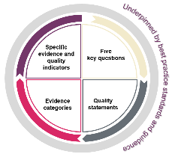
New policy
We’ve developed a single assessment framework, replacing
the current 4 separate frameworks and we'll use it to assess
all service types and as the basis for assessing local authorities
and integrated care systems
Our ratings and 5 key questions will stay central to our approach
We’re replacing our existing key lines of enquiry and prompts with ‘quality statements’
We’re moving away from separate ‘monitor’, ‘inspect’ and ‘rate’ steps
We’ll assess providers in a more flexible way to provide an up-to-date view of quality
It will allow us to better identify trends and patterns across areas
Notes:
New policy –
On the back of strong engagement across all our external audiences we’ve developed a single assessment framework. We’ll use this to assess quality in all service types, and at all levels as well as for local authorities and integrated care systems. This will replace the current four separate frameworks for registering and assessing healthcare and adult social care services.
We confirmed that our ratings and five key questions will stay central to our approach, but we’re replacing our existing key lines of enquiry and prompts with ‘quality statements’. These will reduce the duplication that’s in our current assessment frameworks and will allow us to focus on key topic areas under each key question. We call the quality statements ‘we statements’ as they’re written from a provider, local authority or ICS perspective to help them understand what we expect of them.
Our new assessment approach means we’re moving away from separate ‘monitor’, ‘inspect’ and ‘rate’ steps. Instead, we will use information from a range of sources to assess providers more frequently and in a more flexible way, without being driven by a previous rating. This is key to us achieving our strategic ambition of providing an up-to-date view of quality.
22

Slide 23
Our single assessment framework
Specific
evidence and quality indicators
Five
key questions
Our framework will assess providers, local authorities and integrated care systems with a consistent set of key themes ​
Giving us an up-to-date view of quality​
Helping us better identify trends and patterns across areas
Evidence categories​
Quality statements
https://www.cqc.org.uk/page/single-assessment-framework
Notes:
This is our single assessment framework for our regulation of providers, local authorities and systems. It focus on what matters to people who use health and social care services and their families. It is the key to us providing an up-to-date and accurate view of quality.
So why do we need a single assessment framework?
There are three main reasons why we need to change:
We need to make things simpler so we can focus on what really matters to people.
We need to better reflect how care is actually delivered by different types of service as well as across a local area.
We need one framework that connects our registration activity to our assessments of quality.
This will ultimately give us a clear and up to date view of quality and help us to better identify trends and patterns across the various areas.
23

Slide 24
Five key questions – safe, effective, caring, responsive, well-led
Remaining at the core - aligned with ‘I statements’, based on work by Think Local Act Personal (TLAP), National voices and the Coalition for Collaborative Care on Making it Real.
Focused on what people expect and need from their care.
A basis for gathering structured feedback.
Specific
evidence and quality indicators
Five
key questions
Evidence categories​
Quality statements
https://www.cqc.org.uk/page/single-assessment-framework
Notes:
5 key questions
Our assessment framework is built on our five key questions and our well-known ratings system and is what we use to set out our view of quality and make judgements.
We have drawn on work done previously by Think Local Act Personal (TLAP), National Voices and the Coalition for Collaborative Care on Making it Real. They have co-produced a personalised care and support framework that can be used by people who work in adult social care, health, housing and people who use services. Importantly, this sets out what good and outstanding person-centred care looks like and what people should expect from providers, commissioners and system leaders.
Our framework will also be used to help people understand what a good experience of care looks and feels like by linking it with ‘I statements’ from TLAP’s Making It Real framework. We will use these statements to support us in gathering and assessing evidence of people’s experiences of care. We’re also exploring other ways in which they can be used in our regulation.
24

Slide 25
Specific
evidence and quality indicators
Five
key questions
Quality statements - Expressed as ‘We statements’; the standards against which we hold providers, local authorities and integrated care systems to account
Evidence categories​
Quality statements
https://www.cqc.org.uk/page/single-assessment-framework
Notes:
Quality statements
We are introducing a set of ‘quality statements’, pitched at the level of ‘good’ and linked to the regulations that will help us make our judgments about the quality of care. They will replace our current Key Lines of Enquiry (KLOEs) and prompts and be expressed as ‘we’ statements helping to make things clearer for providers about our expectations on them, while reducing the duplication that currently exists across our KLOEs.
We’ll have a, centred around key topic areas across the key questions. This change is not about overhauling what we look at in our assessments. We’ve streamlined much of the duplication that existed within and acrototal of 34 quality statements the KLOEs, and strengthened some areas, for example around ‘learning cultures’ under Safe - making things clearer for providers.
We will use this set of statements in our assessments of all sectors and service types and at all levels, using them to register services through to our new work looking at local authorities and integrated care systems. This will be the basis for our single assessment framework.
25

Slide 26
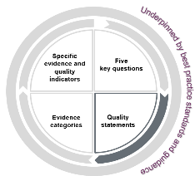

What are quality statements?
Quality statements are the commitments that providers, commissioners and system leaders should live up to. Expressed as ‘we statements’, they show what is needed to deliver high-quality, person-centred care.
The quality statements show how services and providers need to work together to plan and deliver high-quality care. They directly relate to the regulations.
When they refer to 'people' we mean people who use services, their families, friends and unpaid carers.
Source: https://www.cqc.org.uk/assessment/quality-statements

Slide 27


‘I’ statement: When I move between services, settings or areas, there is a plan for what happens next and who will do what, and all the practical arrangements are in place.
‘We/quality’ statement: We work in partnership with others to establish and maintain safe systems of care in which people's safety is managed, monitored and assured, especially when they move between different services.
Notes:
I is the person using the service, and the we is the provider, ICS or LA - it is a commitment on their part
The following quality statements are ‘we’ statements
27

Slide 28
Specific
evidence and quality indicators
Five
key questions
Evidence categories - People’s experience​, feedback from staff and leaders​, feedback from partners, observation, processes, outcomes
Evidence categories​
Quality statements
https://www.cqc.org.uk/page/single-assessment-framework
Notes:
Evidence categories
We want to be more consistent and transparent in our approach and how we make judgments on quality. To address this, we’re developing a way to categorise and score evidence as part of our assessments. The evidence ‘categories’ will bring more structure to our process for assessing quality. The six categories are:
Peoples experiences
Feedback from staff and leaders
Observations of care
Feedback from partners
Processes
Outcomes of care.
To enable us to be clearer with providers and the public about how we use the information we have about care in a service or local area, we will set out which of those evidence categories we will focus on and prioritise for each service type and at each level – including at registration.
28

Slide 29
Specific
evidence and quality indicators
Five
key questions
Specific evidence and quality indicators - Data and information specific to the area of work being considered
Evidence categories​
Quality statements
https://www.cqc.org.uk/page/single-assessment-framework
Notes:
Specific evidence and quality indicators
Our operational colleagues will gather evidence specific to their area of expertise in order to make a judgment.
This will vary depending on the service type – for example, the evidence we can collect in GP practices, will be different to what we’ll have available to us in an assessment of a home care service. They will also depend on the level at which we’re assessing – for example, the evidence we have available to us when a service is registering with us for the first time will be different than when a service has been operating for a while.
By structuring our assessment framework in this way, we can ensure that our assessment framework has the flexibility we need for providers and systems across the health and social care landscape.
In many ways this will all be data and evidence already familiar to providers and to our inspectors. By bringing in the six categories and setting what we always need to collect and review in order to make a decision, alongside a way of scoring evidence, we are able to bring a more structured and consistent framework for assessing quality.
29

Slide 30

Quality statements:
What do we mean by safe? 1/2
Learning culture
We have a proactive and positive culture of safety based on openness and honesty, in which concerns about safety are listened to, safety events are investigated and reported thoroughly, and lessons are learned to continually identify and embed good practices.
Safeguarding
We work with people to understand what being safe means to them as well as with our partners on the best way to achieve this. We concentrate on improving people’s lives while protecting their right to live in safety, free from bullying, harassment, abuse, discrimination, avoidable harm and neglect. We make sure we share concerns quickly and appropriately.
Safe systems, pathways and transitions
We work with people and our partners to establish and maintain safe systems of care, in which safety is managed, monitored and assured. We ensure continuity of care, including when people move between different services.
Involving people to manage risks
We work with people to understand and manage risks by thinking holistically so that care meets their needs in a way that is safe and supportive and enables them to do the things that matter to them.
Source: https://www.cqc.org.uk/assessment/quality-statements
Notes:
Safe
Safety is a priority for everyone and leaders embed a culture of openness and collaboration. People are always safe and protected from bullying, harassment, avoidable harm, neglect, abuse and discrimination. Their liberty is protected where this is in their best interests and in line with legislation.
Where people raise concerns about safety and ideas to improve, the primary response is to learn and improve continuously. There is strong awareness of the areas with the greatest safety risks. Solutions to risks are developed collaboratively. Services are planned and organised with people and communities in a way that improves their safety across their care journeys. People are supported to make choices that balance risks of harm with positive choices about their lives. Leaders ensure there are enough skilled people to deliver safe care that promotes choice, control and individual wellbeing.
Learning culture
We have a proactive and positive culture of safety based on openness and honesty, in which concerns about safety are listened to, safety events are investigated and reported thoroughly, and lessons are learned to continually identify and embed good practices.
Related regulations
Regulated Activities Regulations 2014
Regulation 12: Safe care and treatment
Regulation 16: Receiving and acting on complaints
Regulation 17: Good governance
Regulation 20: Duty of candour
Safe systems, pathways and transitions
We work with people and our partners to establish and maintain safe systems of care, in which safety is managed, monitored and assured. We ensure continuity of care, including when people move between different services.
Related regulations
Regulated Activities Regulations 2014
Regulation 12: Safe care and treatment
Regulation 17: Good governance
Also consider
Regulation 9: Person-centred care
Local authority assessments
We consider this quality statement, safe systems, pathways and transitions, under theme 3: how the local authority ensures safety within the system.
Safeguarding
We work with people to understand what being safe means to them as well as with our partners on the best way to achieve this. We concentrate on improving people’s lives while protecting their right to live in safety, free from bullying, harassment, abuse, discrimination, avoidable harm and neglect. We make sure we share concerns quickly and appropriately.
Related regulations
Regulated Activities Regulations 2014
Regulation 10: Dignity and respect
Regulation 12: Safe care and treatment
Regulation 13: Safeguarding service users from abuse and improper treatment
Also consider
Regulation 9: Person-centred care
Regulation 11: Consent
Regulation 17: Good governance
Regulation 20: Duty of candour
Local authority assessments
We consider this quality statement, safeguarding, under theme 3: how the local authority ensures safety within the system.
Involving people to manage risks
We work with people to understand and manage risks by thinking holistically so that care meets their needs in a way that is safe and supportive and enables them to do the things that matter to them.
Related regulations
Regulated Activities Regulations 2014
Regulation 9: Person-centred care
Regulation 11: Need for consent
Regulation 12: Safe care and treatment
Also consider
Regulation 10: Dignity and respect
30

Slide 31

Quality statements:
What do we mean by safe? 2/2
Safe environments
We detect and control potential risks in the care environment. We make sure that the equipment, facilities and technology support the delivery of safe care.
Infection prevention and control
We assess and manage the risk of infection. We detect and control the risk of it spreading and share any concerns with appropriate agencies promptly.
Safe and effective staffing
We make sure there are enough qualified, skilled and experienced people, who receive effective support, supervision and development. They work together effectively to provide safe care that meets people’s individual needs.
Medicines optimisation
We make sure that medicines and treatments are safe and meet people’s needs, capacities and preferences by enabling them to be involved in planning, including when changes happen.
Source: https://www.cqc.org.uk/assessment/quality-statements
Notes:
Safe environments
We detect and control potential risks in the care environment. We make sure that the equipment, facilities and technology support the delivery of safe care.
Related regulations
Regulated Activities Regulations 2014
Regulation 12: Safe care and treatment
Regulation 15: Premises and equipment
Regulation 17: Good governance
Safe and effective staffing
We make sure there are enough qualified, skilled and experienced people, who receive effective support, supervision and development. They work together effectively to provide safe care that meets people’s individual needs.
Related regulations
Regulated Activities Regulations 2014
Regulation 12: Safe care and treatment
Regulation 18: Staffing
Regulation 19: Fit and proper persons employed
Infection prevention and control
We assess and manage the risk of infection. We detect and control the risk of it spreading and share any concerns with appropriate agencies promptly.
Related regulations
Regulated Activities Regulations 2014
Regulation 12: Safe care and treatment
Regulation 15: Premises and equipment
Also consider
Regulation 17: Good governance
Medicines optimisation
We make sure that medicines and treatments are safe and meet people’s needs, capacities and preferences by enabling them to be involved in planning, including when changes happen.
Related regulations
Regulated Activities Regulations 2014
Regulation 9: Person-centred care
Regulation 12: Safe care and treatment
Also consider
Regulation 11: Need for consent
31

Slide 32
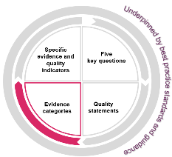

What are evidence categories?
We have grouped the different types of evidence we will look at into 6 categories.
Evidence categories help us to do a few things:
Tailor how we assess quality statements depending on the level or sector we’re focusing on
Collect and store evidence in a structured way
Be more targeted in what we spend our time looking at
Guide how we’ll look at different evidence, supporting colleagues and providers to have a better understanding on the methods we’ll use to collect that evidence
To make clear what we’ll look at in our assessments, we will set out the key evidence categories that we’ll focus on when assessing a particular quality statement.
https://www.cqc.org.uk/assessment/evidence-categories

Slide 33
People’s experience of health and care services
This is all types of evidence from people who have experience relating to a specific health or care service, or a pathway across services. It also includes evidence from families, carers and advocates for people who use services.
We define people’s experiences as:
“a person’s needs, expectations, lived experience and satisfaction with their care, support and treatment. This includes access to and transfers between services”.
Find out about the importance of people’s experience in our assessments
https://www.cqc.org.uk/assessment/evidence-categories
Notes:
Evidence from people’s experience of care includes:
phone calls, emails and Give feedback on care forms received by CQC
interviews with people and local organisations who represent them or act on their behalf
survey results.
feedback from the public and people who use services obtained by:
community and voluntary groups
health and care providers
local authorities
groups representing:
people who are more likely to have a poorer experience of care and poorer outcomes
people with protected equality characteristics
unpaid carers
33

Slide 34
Feedback from staff and leaders
This is evidence from people who work in a service, local authority or integrated care system, and groups of staff involved in providing care to people.
It also includes evidence from those in leadership positions.
This includes, for example:
results from staff surveys and feedback from staff to their employer
individual interviews or focus groups with staff
interviews with leaders
feedback from people working in a service sent through our Give
feedback on care service
whistleblowing
https://www.cqc.org.uk/assessment/evidence-categories
Notes:
34

Slide 35
Feedback from partners
This is evidence from people representing organisations that interact with the service or organisation that is being assessed.
We may gather evidence through interviews and engagement events.
The organisations include, for example:
commissioners
other local providers
professional regulators
accreditation bodies
royal colleges
multi-agency bodies.
https://www.cqc.org.uk/assessment/evidence-categories
Notes:
35

Slide 36
Observation
Observing care and the care environment will remain an important way to assess quality.
Most observation will be carried out on the premises by CQC inspectors and Specialist Professional Advisors (SpAs).
External bodies may also carry out observations of care and provide evidence, for example, Local Healthwatch. Where the evidence from organisations such as Healthwatch is specifically about observation of the care environment, we will include it in this category, and not in the people’s experiences category.
We will not use the observation category for local authority assessments. It
does not apply to a local authority context.
All observation is carried out on site.
https://www.cqc.org.uk/assessment/evidence-categories
Notes:
36

Slide 37
Processes
Processes are the series of steps, arrangements or activities that a provider or organisation carries out to deliver safe care that meets people's needs.
Our assessments focus on how effective processes are to the relevant quality statement. To do this, we will look at information and data sources that measure how well processes work. Examples of evidence for processes include:
results from audits a provider has developed or from national programmes (for example, the National Clinical Audit and Patient Outcomes Programme)
findings and learning from safety incidents
access times for treatment and care
case note reviews of people's care or clinical records.
https://www.cqc.org.uk/assessment/evidence-categories
Notes:
37

Slide 38
Outcomes
Outcomes are focused on the impact of care processes on individuals. They cover how care has affected people’s physical, functional or psychological status.
We consider outcomes measures in context of the service and the specifics of the measure.
Some examples of outcome measures are:
mortality rates
emergency admissions and re-admission rates to hospital
infection control rates
vaccination and prescribing data.
https://www.cqc.org.uk/assessment/evidence-categories
Notes:
We also source the information from:
patient level data sets
national clinical audits
initiatives such as the patient reported outcome measures (PROMs) programme.
38

Slide 39
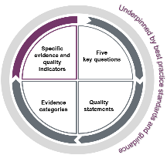
Evidence category requirements
Throughout much of our model, ‘what’ we’re looking at
isn’t changing a huge amount but ‘how’ we’ll do it is
changing.
Evidence categories are there to put a more systematic process around the information that already existed in health and social care, which we’d have collected on a routine basis.
An example of a provider type giving details on a specific quality statement and the types of evidence we would look for.
We have now published evidence category requirements for 8 sectors, for more information – please follow the link below;
https://www.cqc.org.uk/assessment/evidence-categories/evidence-categories-sector-groups

Slide 40
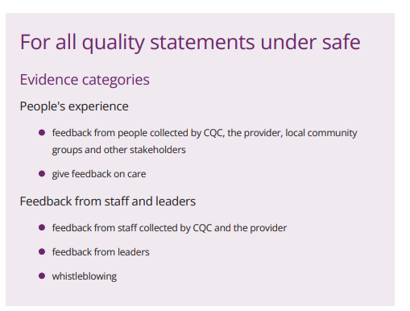

Evidence category guides
https://www.cqc.org.uk/assessment/evidence-categories
Notes:
We also source the information from:
patient level data sets
national clinical audits
initiatives such as the patient reported outcome measures (PROMs) programme.
40

Slide 41
Effective
Care homes example
Assessing needs; We maximise the effectiveness of people’s care and treatment by assessing and reviewing their health, care, wellbeing and communication needs with them.
Quality statement
Key evidence category
People's experience
Processes
Feedback from people collected by CQC, the provider, local community groups and other stakeholders
Give feedback on care
Assessments and records of meeting needs under the Equality Act 2010
Assessments and/or best interest decisions under the MCA
Clinical tools to assess pain and monitor risk
People’s care records or clinical records
Evidence type examples
https://www.cqc.org.uk/assessment/evidence-categories/care-homes-and-supported-living-services-evidence-categories
Notes:
We want to be clear with providers about the evidence we will be looking for as part of our assessments. This will vary depending on a number of things, for example the type or model of service or whether it’s at registration. It’s vital that we tailor our single assessment framework so it works for everyone.
To do this we have set out the key evidence categories we’ll collect evidence in to assess each quality statement in your sector.
In this example, we’re looking at the Assessing needs for Care homes. You can see that there are two of key categories noted:
People’s experiences in health and social care
Processes
This means that each time we come to assess this quality statement, we’ll have used evidence in each of these categories to come to a judgement.
It will only be the first assessment under our new approach, and for services newly registering with us, that we’ll look at every key evidence category though. Future assessments could include a blend of new and existing evidence.
A further way of tailoring our assessment framework is by setting out some example types, these you can see along the bottom row. These should be viewed as examples only, and not a checklist that providers should be using.
41

Slide 42
How do we reach a rating
The following guidance only applies to providers/services that we rate and covers:
  Structured evidence collection
  Scoring evidence categories
  How evidence category scores give us quality statement scores
  How quality statement scores give us key question scores and ratings
  Where the score or rating may be adjusted (moderation and scoring rules)
  What scores/ratings we publish
Notes:
42

Slide 43
An overview: How do we reach a rating
We structure evidence collection by defining which evidence categories we use. We score the evidence categories to support transparent and consistent judgements.
The quality statements describe the standards of care that people should expect. They each get a score produced from the evidence category scores.
We ask the same five key questions of all providers we regulate. The key questions are given a score and a rating using the quality statement scores.
We also give an overall service rating produced by aggregating the 5 key question ratings.
Evidence category scores
(given by inspector/ assessor)
Quality statement scores
(produced by scoring model)
Key question score and rating
(produced by scoring model)
Key question ratings then determine the overall rating
Notes:
In NHS acute hospitals and independent hospitals, we also produce a location rating by aggregating the service level ratings
We assess the well-led key question at the NHS Trust level to give us the Trust level rating (this is not produced through aggregation)
43

Slide 44
Example: QS – involving people to manage risk
Required categories:
People’s experience
Feedback from staff and leaders
Observation
Feedback from partners
Processes
Outcomes
Scores given:
Peoples experience 3
Feedback from staff and leaders 3
Observation 3
Processes 2
Scoring scale
  4. Evidence shows an exceptional standard of care
  3. Evidence shows a good standard of care
  2. Evidence shows some shortfalls in the standard of care
  1. Evidence shows significant shortfalls in the standard of care
All categories have equal weight
Total of 11 (out of a possible 16)
69%
3
Quality statement score

Slide 45
Example: continued
25-38 | Inadequate
39-62 | Requires improvement
63-87 | Good
≥87 | Outstanding
Total of 22 (out of a possible 32)
69%
SAFE
Good
Key question ratings then determine the overall rating
Remember… 8 is the minimum score (not zero)

Slide 46
Best practice guidance
All sectors
Multiple Sectors
One sector
One service type
We link quality statements to best practice guidance we expect providers to follow.
We classify guidance based on applicability.

Slide 47
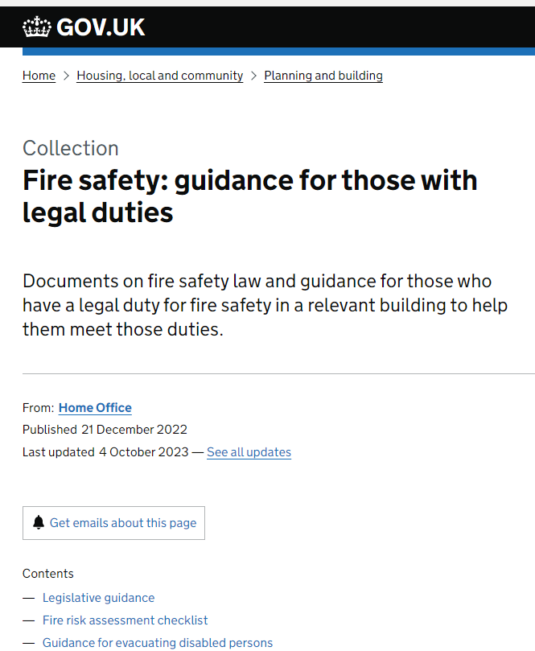




Best practice guidance
All sectors
One sector
One service type
Multiple Sectors

Slide 48

Best practice guidance
One service type
Multiple Sectors
One sector
All sectors

Slide 49
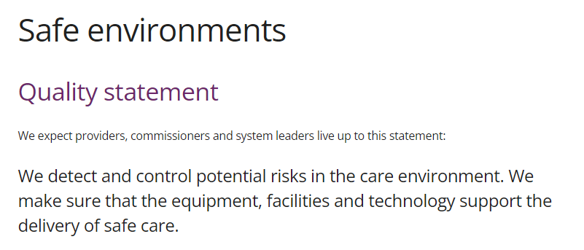
Level 1 guidance

Slide 50
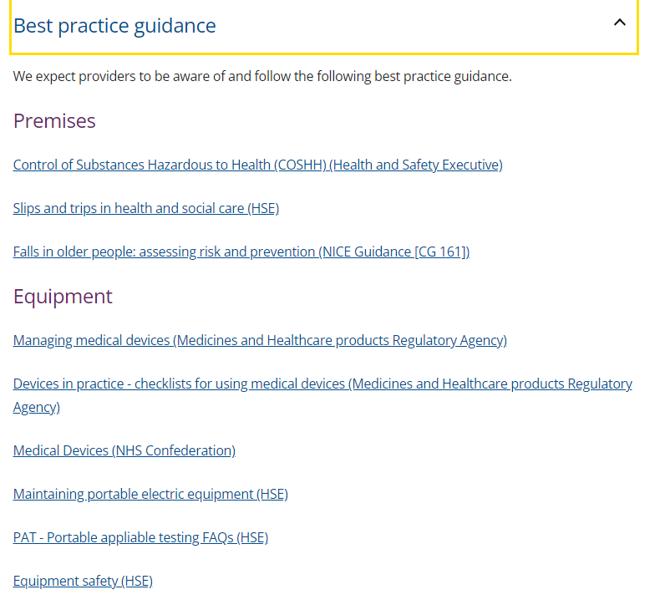
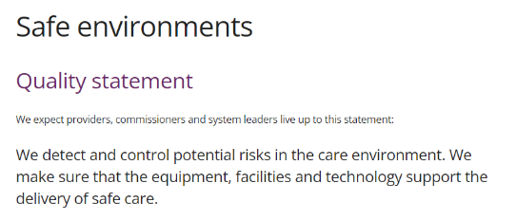
https://www.cqc.org.uk/guidance-regulation/providers/assessment/single-assessment-framework/safe/safe-environments
Notes:
50

Slide 51

Our new teams
Notes:
We’re bringing together our sector teams (adult social care, hospitals, primary medical services) into one Operations group.
Our operational activity will work across four geographic areas or ‘networks’ and will be responsible for carrying out our assessments of quality. The four networks are:
North
Midlands
London and East of England
South.
Within these networks we’ll divide ourselves into teams at a local level (around 110/115) that include colleagues with a mix of expertise and experience of different types of health and social care services to make sure we can share specialist skills and knowledge about all sectors. This means bringing people together who have different perspectives to give us the best view of services across a local area.
In practice, this means our new teams will be made up of inspectors, assessors, regulatory coordinators and regulatory offices. Each team will be led by an operations manager and contain a mix of these roles depending on the services in a particular area. There will be around 9-12 people in each team.
While colleagues will retain their sector specialism, they’ll also have access to senior specialists in each sector who will provide additional expertise, in addition to our continued use of specialist advisors.
As part of this wider group, we are also establishing a National Operations directorate, which will include our registration team and our national operations teams such as those looking at oral health, and children’s services. This will also include our registration team.
All of these colleagues will be supported by a central hub that will:
monitor performance, risk and assurance
oversee wellbeing, learning and development
share best practice and standards
ensure consistency.
We now have a new senior leadership team that leads our Operations group. The team comprises Director roles that replace the existing role of a Deputy Chief Inspector.
51

Slide 52
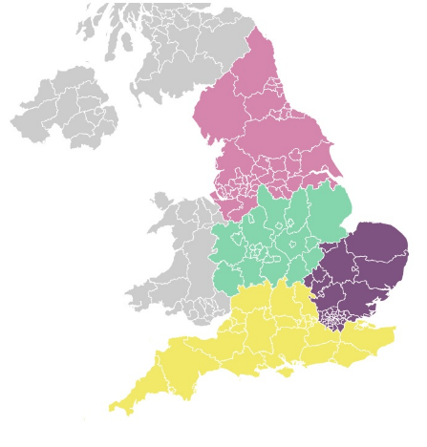
New way of organising
We’ve re-organised the Operations group and Regulatory leadership
Regulatory leadership is led by the Chief
Inspectors, and focuses on raising standards,
policy oversight, and external influence
Our operational teams work across 4
geographic networks, with a mix of specialist
skills and knowledge to regulate in a way that
mirrors how care is delivered
We’ll have a view of systems and focus on listening to
people and communities
Notes:
New structure ­–
We’ve begun to reorganise ourselves by establishing our new Operations group and Regulatory leadership functions.
Our regulatory leadership function will be led by the Chief Inspectors, and focus on raising standards, having oversight of policy and playing a more influential role externally to support quality improvement and innovation
Our Operations group will be responsible for our regulatory activity, and has brought together three sectors. Our operational teams now work across four Networks or geographic areas (North, Midlands, London East of England and South) to deliver our regulatory activity so that we can begin to build a better picture of quality across an area.
We are still designing how much of this will work in detail, but we do know we’ll create multidisciplinary teams with specialist skills and knowledge, meaning we’re able to regulate in a way that mirrors how care is delivered today
52

Slide 53
Our new teams
How we'll deliver assessments
Bringing together all our sector specialists into one team
Based around 4 geographic areas or ‘networks’
Teams will be led by an operations manager, and made up of inspectors, assessors, regulatory co-ordinators and regulatory officers
Supported by senior specialists
National operations
All supported by a central hub
Notes:
We’re bringing together our sector teams (adult social care, hospitals, primary medical services) into one Operations group.
Our operational activity will work across four geographic areas or ‘networks’ and will be responsible for carrying out our assessments of quality. The four networks are:
North
Midlands
London and East of England
South.
Within these networks we’ll divide ourselves into teams at a local level (around 110/115) that include colleagues with a mix of expertise and experience of different types of health and social care services to make sure we can share specialist skills and knowledge about all sectors. This means bringing people together who have different perspectives to give us the best view of services across a local area.
In practice, this means our new teams will be made up of inspectors, assessors, regulatory coordinators and regulatory offices. Each team will be led by an operations manager and contain a mix of these roles depending on the services in a particular area. There will be around 9-12 people in each team.
While colleagues will retain their sector specialism, they’ll also have access to senior specialists in each sector who will provide additional expertise, in addition to our continued use of specialist advisors.
As part of this wider group, we are also establishing a National Operations directorate, which will include our registration team and our national operations teams such as those looking at oral health, and children’s services. This will also include our registration team.
All of these colleagues will be supported by a central hub that will:
monitor performance, risk and assurance
oversee wellbeing, learning and development
share best practice and standards
ensure consistency.
We now have a new senior leadership team that leads our Operations group. The team comprises Director roles that replace the existing role of a Deputy Chief Inspector.
53

Slide 54
Three reasons why
Bringing together sector specialists in teams and breaking down previous barriers that separated the different sectors we’re more able to look at quality across a local area
Splitting our roles and responsibilities involved in carrying out assessments means we’re able to be more efficient & effective and give a more up-to-date view of quality. This is enhanced by introducing a central hub to better manage where we focus our time.
The roles we’re creating are able to provide more efficient and tailored support, having access to, and regular conversations with, members of our teams, depending on what you need.

Slide 55

Roles in detail - assessor
Sector specialist accountable for ongoing view of quality, safety and risk.
Make judgements as part of assessments, working with inspector and the rest of the team to bring together evidence
Decides on and authorises regulatory activity
Supports off-site evidence collection
Notes:
55

Slide 56

Roles in detail - inspector
Sector specialist accountable for carrying out site visits for the purposes of gathering evidence (inspections)
Lead enforcement activity
Work with assessor to support decision making on judgments of quality
Develop relationship with provider to support on-site activity

Slide 57

Roles in detail – co-ordinator
Carry out day-to-day engagement activity with providers and local groups representing people who use services and other stakeholders
Support triage of information
Support collection of evidence
Support planning and completion of inspections

Slide 58
Roles in detail - Operations Manager
Manages integrated, cross sector team
Has overview of quality and safety in an area
Not a sector specialists
Notes:
58

Slide 59

Roles in detail – senior specialist
Sits across a network to support teams by providing expert advice on complex and high-risk issues to inform their decision making
Assists external work as required, particularly with senior stakeholders

Slide 60
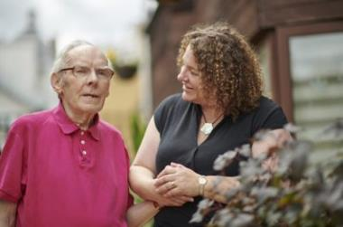
Digitisation in social care: why it matters
Notes:
So the other aspect I’m keen to touch on is digitization in social care and to make it really clear that CQC fully supports the adoption of digital social care records
And Why ? CQC know that good quality records underpin safe, effective, compassionate, high-quality care. They ensure that accurate information gets to the right people, when they need it.
and digital record systems far exceed the capabilities and benefits of paper-based records.
Because they help providers to minimise the risks to peoples’ safety
They support their staff to respond more quickly to peoples’ needs
and share important information quickly and safely
And for providers they don’t just help underpin good quality care, they
Help you operate more efficiently
They give management information and insight not possible with paper records.
And that's just the start, when you look at the systems available, you'll see they are innovating with other digital features that help improve the quality of care for service users and their families.
But there’s another benefit that’s even more important than all of this:
In CQC’s State of Care report last year we said - Better data and data sharing are the critical components before providers can begin to address system-wide issues in a meaningful way
We know that the integrated nature of health and care demands that we have a full picture of the people’s experience, so we can understand and address these issues
60

Slide 61
Digitisation in social care: why it matters
Good quality records underpin high-quality care
Digital records far exceed capabilities of paper
  Efficiency, automation, reporting and sharing
And that's just the start of innovation ….
State of Care Oct 2022 - Better data and data sharing are the critical components before providers can begin to address system-wide issues in a meaningful way
Notes:
So the other aspect I’m keen to touch on is digitization in social care and to make it really clear that CQC fully supports the adoption of digital social care records
And Why ? CQC know that good quality records underpin safe, effective, compassionate, high-quality care. They ensure that accurate information gets to the right people, when they need it.
and digital record systems far exceed the capabilities and benefits of paper-based records.
Because they help providers to minimise the risks to peoples’ safety
They support their staff to respond more quickly to peoples’ needs
and share important information quickly and safely
And for providers they don’t just help underpin good quality care, they
Help you operate more efficiently
They give management information and insight not possible with paper records.
And that's just the start, when you look at the systems available, you'll see they are innovating with other digital features that help improve the quality of care for service users and their families.
But there’s another benefit that’s even more important than all of this:
In CQC’s State of Care report last year we said - Better data and data sharing are the critical components before providers can begin to address system-wide issues in a meaningful way
We know that the integrated nature of health and care demands that we have a full picture of the people’s experience, so we can understand and address these issues
61

Slide 62
What do good digital social care records look like?
Minimum requirements:
each person using its service
the employment of staff
the overall management of the regulated activity.
This applies to paper and digital records. Records must be accurate, complete and up-to-date.
We routinely look at a provider’s records as part of our inspection activity, focusing on:
the information in the records
how that information is used
the security measures to store and share the information.
We do not endorse or recommend a specific digital social care record system.
The Digitising Social Care programme provides resources to help you when choosing a digital social care record system.
Notes:
What do good digital social care records look like?
Assessing and inspecting
As with all aspects of care, we will assess records against our current key lines of enquiry. Later in the year, we will implement our new regulatory approach and continue to assess records using our new single assessment framework. We will update this guidance as appropriate to reflect any changes.
We do not assess the standard or technical functioning, or capabilities of the digital record systems themselves.
62

Slide 63
The benefits of a good digital records system
For people using services:
It’s easier for people to access their own records.
People will be able to spend more time with staff and engage in meaningful interactions with them.
When people’s needs change, services will be able to respond quickly and share information with partners in their care, making care safer.
Risks such as medication errors, dehydration or missed care visits will be minimised.
For providers and staff:
Recording information in real time will allow people in different locations to access and update it wherever they are.
Staff will be able to do their job more effectively and efficiently.
Digital systems will support effective quality monitoring of the service, enabling services to share and compare data to improve people’s care.
Storing information digitally is easier and needs less physical space.
People’s information will be handled more securely through automatic back-up of data, the cyber security of cloud-based services, and by using multi-factor authentication.
For the wider health and social care system:
People’s information can be used across the local health and care system to make sure their care is joined up and to support the needs of the local population.
There will be better use of resources across the local health and care system, which can help to support other important health and care functions, such as service management, planning and research.

Slide 64
Working with CQC – points to consider
We are aware that you need to meet your own data governance requirements, particularly around preventing accidental changes or loss of data. Read-only access to records means you can be confident that you can prevent accidental data changes or loss.
If you have guest log-in details for the system, you should provide these where you and the inspection team member are confident that they can independently access the records they need to see. Where available, this should be read-only access. You should not use the log-in details (including smart cards) of anyone who is not present.
If read-only access is not available or the inspection team member needs support to use the system, you should help them to access the records they ask to see. For example, you could have a staff member available.
Notes:
We are aware that you need to meet your own data governance requirements, particularly around preventing accidental changes or loss of data. Read-only access to records means you can be confident that you can prevent accidental data changes or loss.
If you have guest log-in details for the system, you should provide these where you and the inspection team member are confident that they can independently access the records they need to see. Where available, this should be read-only access. You should not use the log-in details (including smart cards) of anyone who is not present.
If read-only access is not available or the inspection team member needs support to use the system, you should help them to access the records they ask to see. For example, you could have a staff member available.
Generally, where an inspection team member can access the digital records they need, they will not ask for paper copies. However, there are circumstances where you should provide hard copies, for example if waiting for a member of staff to assist would prevent them from carrying out their inspection activity. We may request specific formats where it is necessary for regulatory decision making or taking enforcement action. We will explain this request clearly.
64

Slide 65
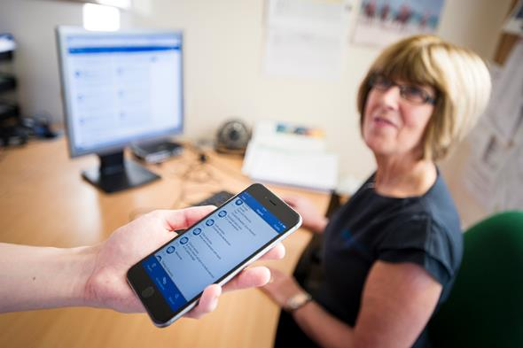
Find out more
We are here to help you
We are here to support you
Sources of best practice and much more, can be found on our webpage
https://www.cqc.org.uk/guidance-providers/adult-social-care/digital-record-systems-adult-social-care-services
Notes:
Sources of best practice and guidance
65

Slide 66









Stay informed and stay in touch
Provider Bulletin
https://www.cqc.org.uk/news/newsletters-alerts/email-newsletters-cqc or Search: CQC bulletin
Social
@CQCProf @CQCProf
youtube.com/user/cqcdigitalcomms
facebook.com/CareQualityCommission
Digital platform
https://cqc.citizenlab.co/en-GB/ or Search: Citizenlab CQC
CQC is changing
https://youtube.com/playlist?list=PLEwLzOd_XW-IU-FCX2gvNu3OYG1aHn365
Podcasts
Wherever you listen to podcasts
Search: CQC Connect
Blogs
https://medium.com/@CareQualityComm
or Search: Medium CQC
Publications
https://www.cqc.org.uk/publications
Notes:
66

Slide 67

John Clifford
Senior Specialist
www.cqc.org.uk
enquiries@cqc.org.uk
@CQCProf
youtube.com/user/cqcdigitalcomms
facebook.com/CareQualityCommission
Notes:
67

